Slide 1

Everything you always wanted to know about Open Educational Resources
(but were afraid to ask)
Robert Schuwer 23-03-2022

Slide 2

Agenda
OER 101
History
Policies and strategies
Practices of adoption
Some cases

Slide 3


Slide 4
What are learning resources (materials)?
“Learning resources are a subset of educational tools. Educational tools include anything used by instructors and/or students (including computers, electronic learning environments and smart boards) in and for the purpose of teaching or learning. The term learning resources refers only to learning content in a particular form (textual, visual, auditory, or a mix of these forms)”
(Janssen & Van Casteren, 2020)

Slide 5
What are Open Educational Resources (OER)?
“Open Educational Resources (OER) are learning, teaching and research materials
in any format and medium
that reside in the public domain or are under copyright that have been released under an open license,
that permit no-cost access,
re-use, re-purpose, adaptation and redistribution
by others.”
(UNESCO, 2020)

Slide 6
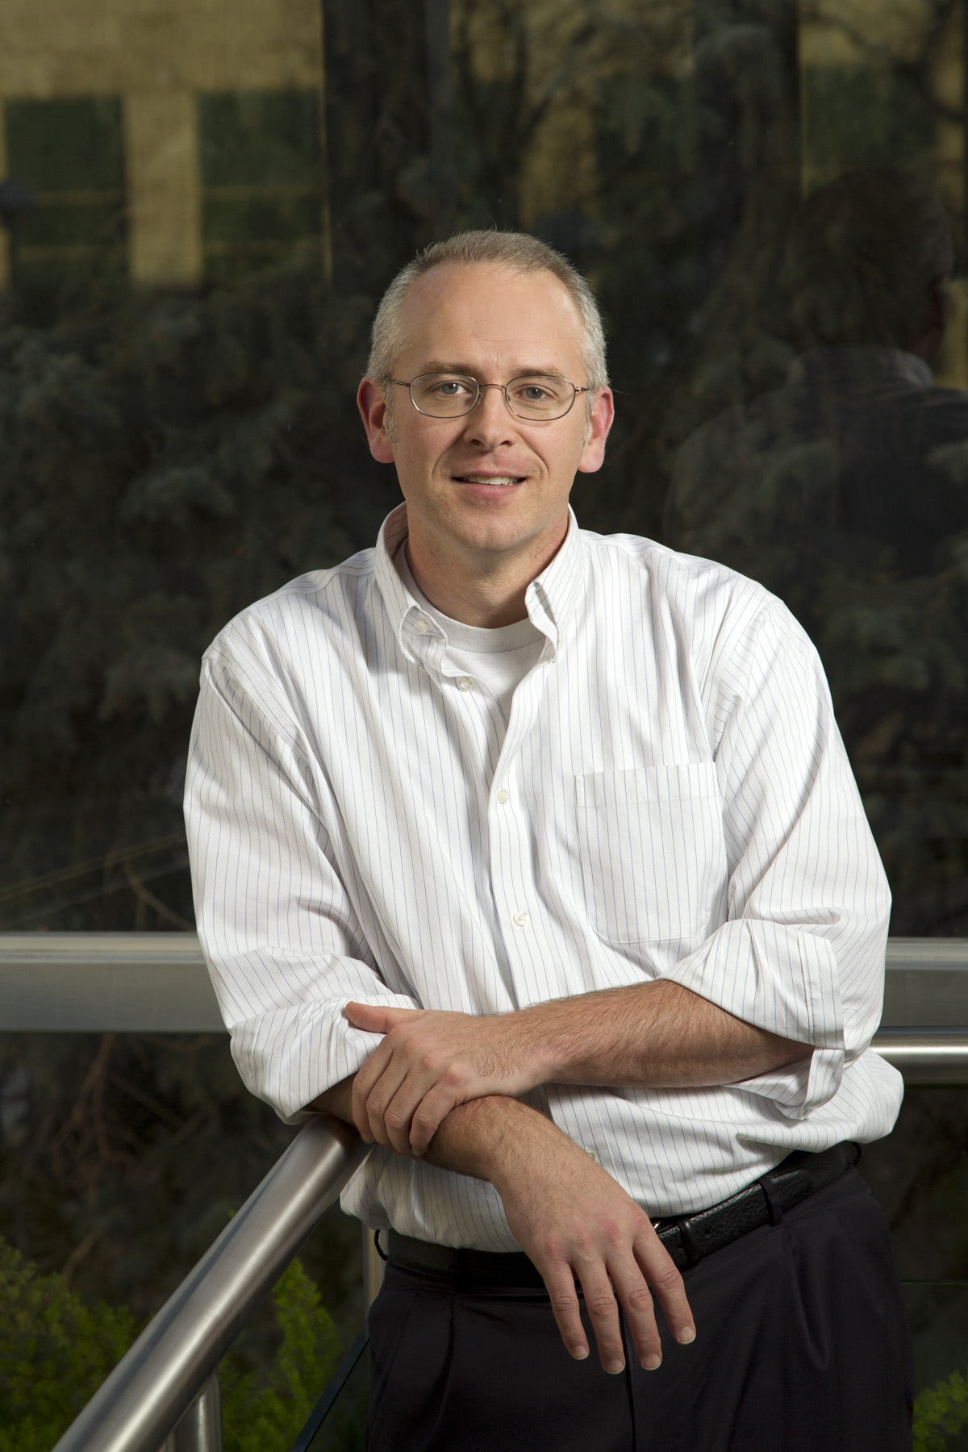
What rights?
5R
  Retain
  Reuse
  Revise
  Remix
  Redistribute
Open license:
  Conditions to exercise the rights
  Creative Commons
(Wiley, n.d.)

Slide 7

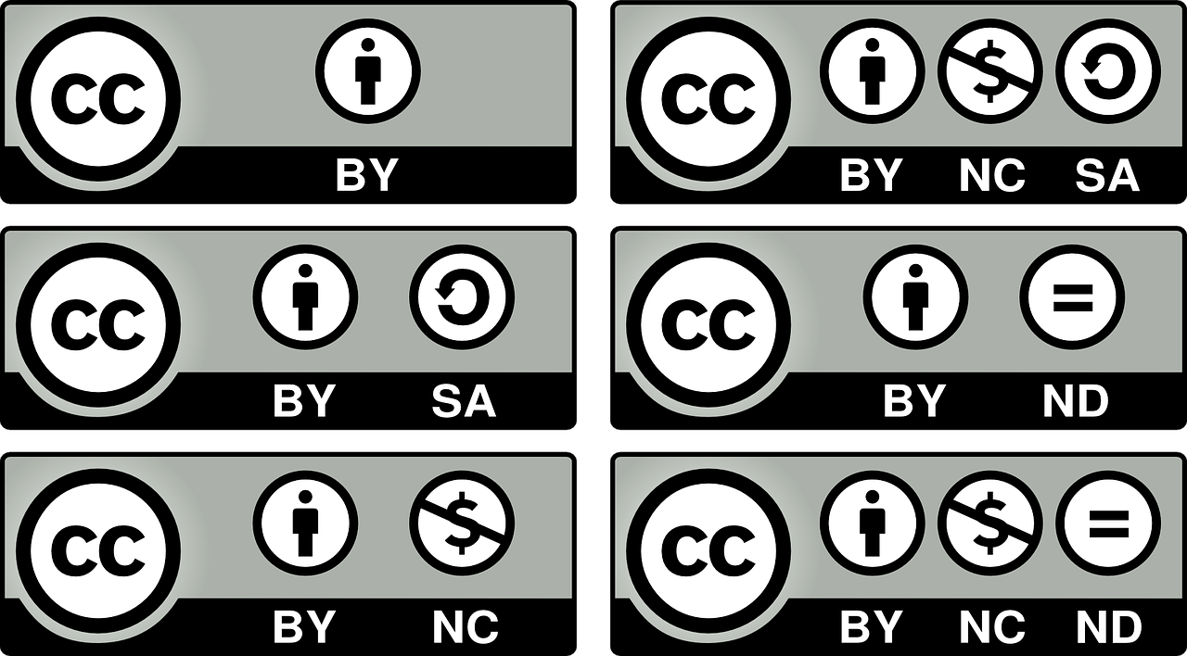



Creative Commons Licenses
4 building blocks
Most open
Attribution
(BY)
Share Alike
(SA)
Non Commercial
(NC)
No Derivatives
(ND)
Least open

Slide 8



Other licenses
CC0: no conditions
Public Domain: no conditions (by law after a specific time)
©: No rights without permission of the owner

Slide 9
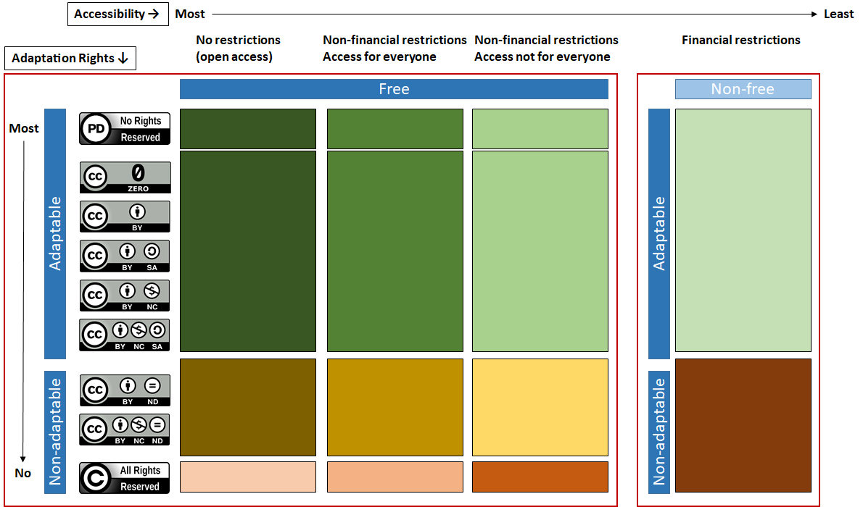
(Schuwer & Janssen, 2021a)

Slide 10
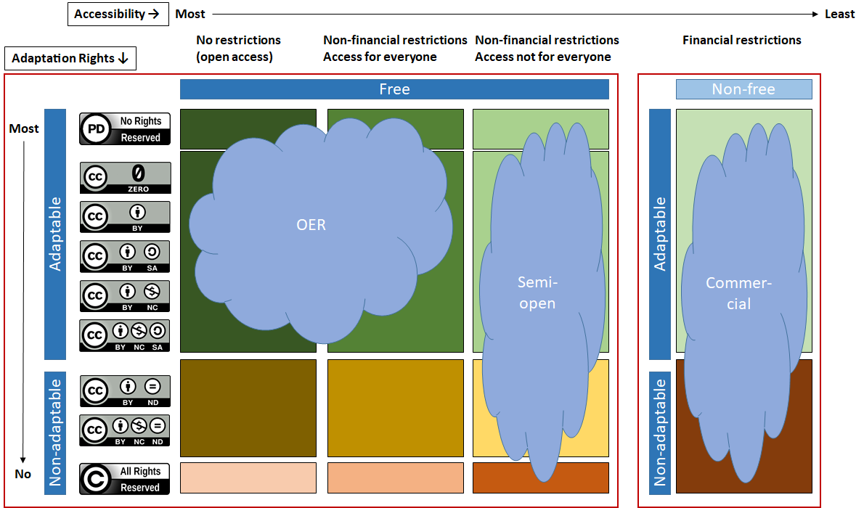

Slide 11
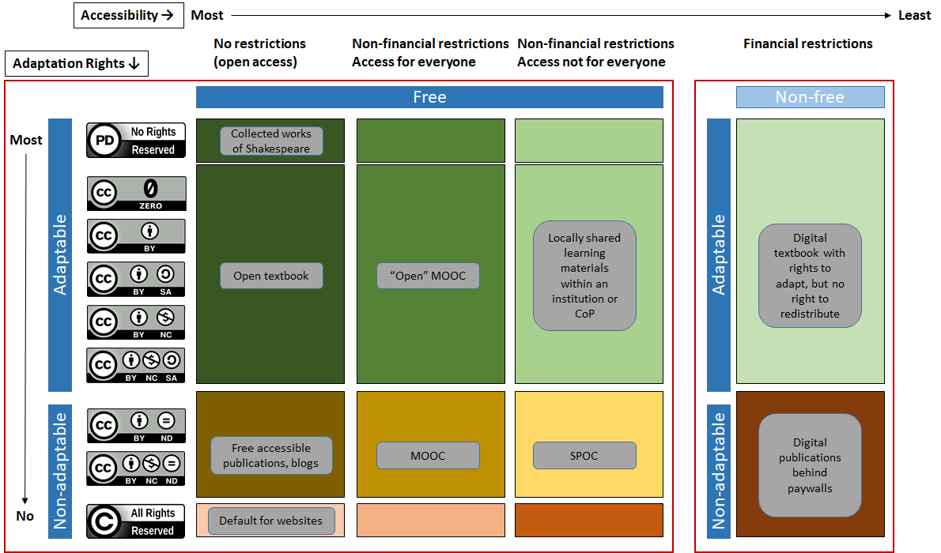

Slide 12
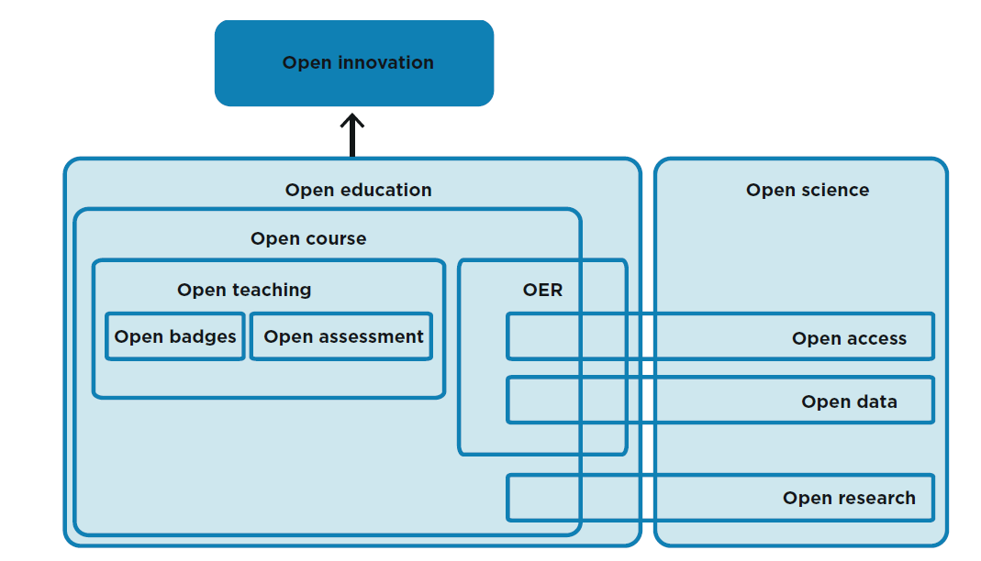
Open Ecosystem
(Woert, Schuwer & Ouwehand, 2015)

Slide 13











2001
2002
2006
2008
2010
2012
2014
2016
2018
2020
2022

Slide 14
Open policies
UNESCO SDG 4: “Ensure inclusive and equitable quality education and promote lifelong learning opportunities for all”
OER is an important tool to reach this goal
Policy on OER is needed to coordinate, strengthen, and guide initiatives within a country or institution

Slide 15
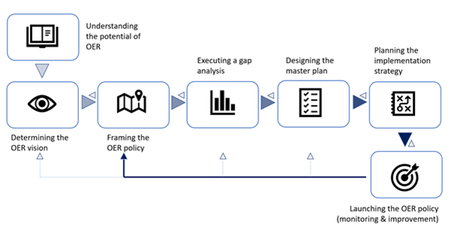
Framework
From: Guidelines on the Development of Open Educational Resources Policies
(Miao et al, 2019)

Slide 16
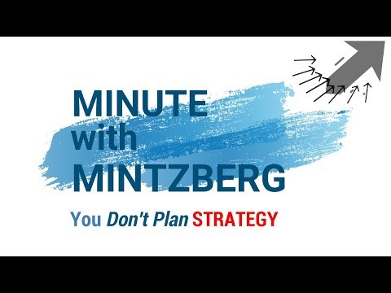
Context, context, context
Policies are always context dependant
Dialogue is key
Other policies can serve as inspiration

Slide 17
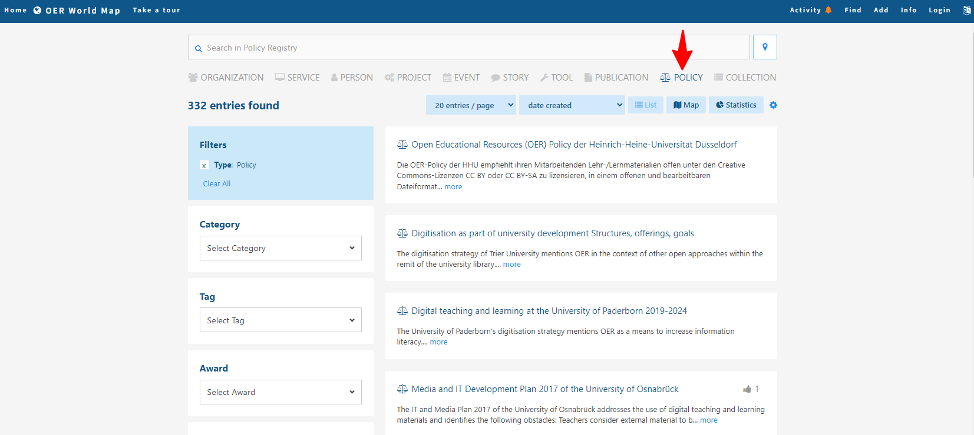
OER World Map
https://oerworldmap.org/resource/

Slide 18
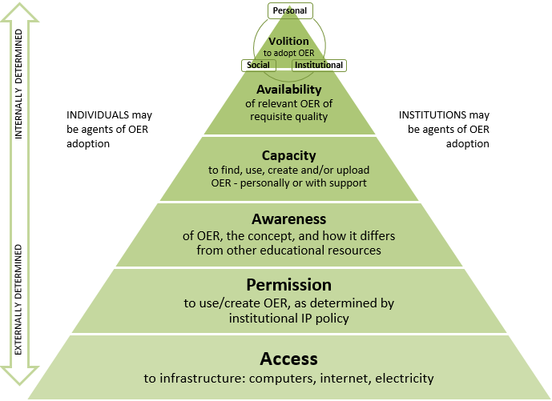
What is needed for sharing and reuse of OER?
(Cox & Trotter, 2017

Slide 19

Volition: barriers for teachers
Lack of time
Lack of clarity regarding the added value of OER (what’s in it for me)
No perceived recognition and appreciation for sharing OER
Insufficient skills regarding the findability of OER, copyright issues, and the possibilities for using them
Lack of clarity about quality of both retrieved OER and the learning resources to be shared
Insufficient perceived support in the areas of educational technology, ICT, and copyright.
No overall solution. Commercial learning resources are often accompanied by test banks, slides, and other supplementary material. OER often lack an overall solution of this kind.
(Schophuizen et al, 2017; Schuwer & Janssen, 2018; Baas et al, 2019; Schuwer & Janssen, 2021b)

Slide 20
Volition: barriers for institutions
No control over guaranteeing the quality of learning resources published under the institution’s banner
Uncertainty regarding the added value of OER within the context of the institution
Lack of clarity on how to encourage instructors to adopt OER within their teaching. (How to address sentiments such as “not invented here”, “my content is king”, or “I created it in my own time so the institution does not own it”?)
Lack of clarity on how adoption of OER can be made sustainable (not dependent on one-off project subsidies).

Slide 21
Motivations (generic added value)
Quality
Efficiency
Inclusiveness
Marketing and profiling
(Study) benefits
Research and innovation

Slide 22
Motivations (derived added value)
Contributing to flexibilisation
Cooperation regionally and internationally
Safeguarding public values
  E.g. what has been paid for with public money must also be made publicly available
  Ethical dimensions

Slide 23
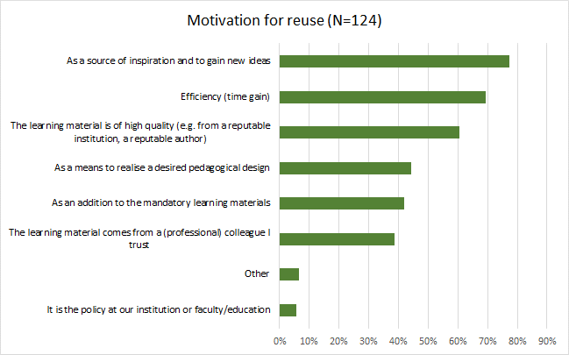
(Baas & Schuwer, 2020)

Slide 24
Trend towards ethical dimensions: Open Pedagogy
Open Pedagogy
1. Open Accessible Added Value
2. Connecting Open Communities
3. Create and Share Knowledge
4. Learning Tasks With OER
Create and share formative test items
Create a blog, book or reader
Student agency
Find and use OER in lesson
Create OER reader, each year supplemented by student for students in the next cohort
Collaborate on open textbook
Study a MOOC
Work and learn in lab/CoP
Suppelment local news on wikipedia
Co-author paper (open science)
Record knowledge clips on video
(Jacobi et al, 2019)

Slide 25
Case Wikiwijs
Platform for creating, sharing and finding OER
Initiated by Dutch government 2008
Program 2009-2013
Maintained and extended by Kennisnet

Slide 26
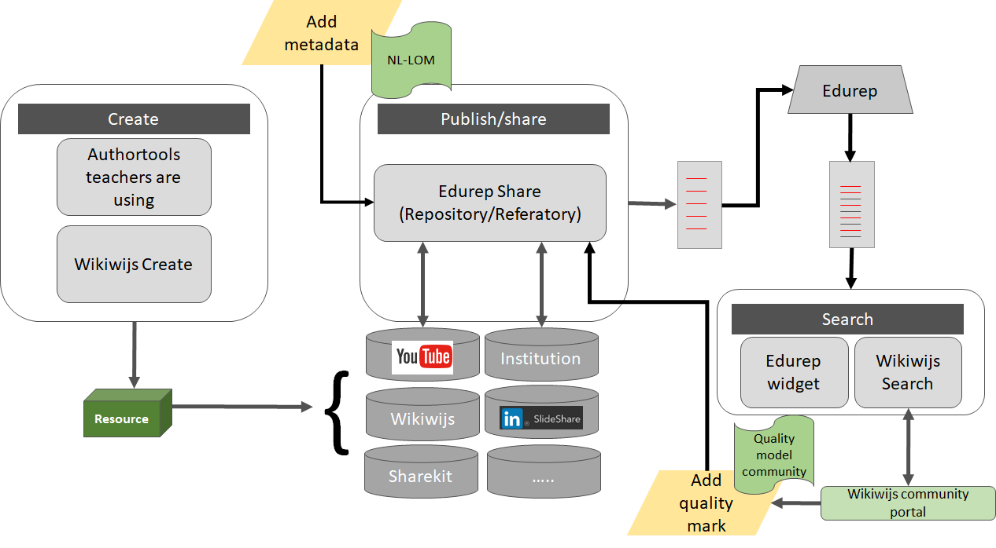
*
*
*
*

Slide 27
Case Together Nursing (2017-2020 and beyond)
Motivation
  BN2020
Approach
  Quality model
  Community of Practice
  Creating new OER and curation of third party OER
  Wikiwijs
Results (October 2020)
  ~ 1400 OER available
  Several hundreds of teachers connected
More information: https://samenhbovpk.blogspot.com/ (in Dutch)

Slide 28
Case NDLA
Nasjonal digital læringsarena (Norwegian Digital Learning Arena)
Government agency set up by 18 Norwegian districts to provide high quality OER to secondary schools
Budget: 20% of total available from districts
Collaboration with educational institutions
(Müller, 2021; Janssen & Van Casteren, 2020, 34-39)

Slide 29


r.schuwer@fontys.nl

Slide 30
Suggested readings
Title | URL
An Introduction to OER | https://iastate.pressbooks.pub/oerstarterkit/chapter/introduction/
Critical Evaluation of Quality Criteria and Quality Instruments in OER Repositories for the Encouragement of Effective Teacher Engagement | http://lre.eun.org/wp/LRE_White_paper_003.pdf
The evolution of sustainability models for Open Educational Resources: insights from the literature and experts | https://doi.org/10.1080/10494820.2020.1839507
Open Pedagogy: A Systematic Review of Empirical Findings | https://jl4d.org/index.php/ejl4d/article/view/511

Slide 31
Suggested websites with OER and other open stuff
Name | Description | URL
Lumen Learning | Open interactive courses | https://lumenlearning.com/courses/
OERCommons | Public digital library of OER | https://www.oercommons.org/
OpenStax | Free open textbooks | https://openstax.org/
ORCA.nrw | Open Resources Campus Nordrhein-Westfalen in Germany | https://www.orca.nrw/
Saylor.org | Open courses | https://learn.saylor.org/
Class Central | Search portal for MOOCs | https://www.classcentral.com/
Collection of websites | Overview of websites with OER resources | https://www.robertschuwer.nl/?page_id=309
Curated overview of open resources | Overview of websites with free to use, open resources: images, video, audio & miscellaneous | https://www.robertschuwer.nl/?page_id=2441

Slide 32
References
Baas, M., Admiraal, W., & Van den Berg, E. (2019). Teachers’ Adoption of Open Educational Resources in Higher Education. Journal of Interactive Media in Education, 2019(1): 9, pp. 1-11. DOI: 10.5334/jime.510
Cox, G., & Trotter, H. (2017). An OER framework, heuristic and lens: Tools for understanding lecturers’ adoption of OER. Open Praxis, 9(2), 151-171. doi: http://dx.doi.org/10.5944/openpraxis.9.2.571
Jacobi, R., Schuwer, R., Woert, N. (2019). Themauitgave Open Pedagogy. Er is meer Open Pedagogy dan je denkt. SURF, Nederland. https://www.robertschuwer.nl/download/OpenPedagogyNL.pdf
Janssen, B. & Van Casteren, W. (2020). Digitale leermaterialen in het hoger onderwijs. Onderzoek in opdracht van het Koersteam Versnellingsplan Onderwijsinnovatie met ICT. Utrecht: Versnellingsplan Onderwijsinnovatie met ICT. https://www.versnellingsplan.nl/wp-content/uploads/2021/09/Rapport-zone-digitale-leermaterialen-in-hoger-onderwijs.pdf
Miao, F., Mishra, S., Orr, D., & Janssen, B. (2019). Guidelines on the development of open educational resources policies. UNESCO Publishing. http://oasis.col.org/bitstream/handle/11599/3455/2019_Guideliness_OER_Policy_final_COL_web.pdf
Müller, F. J. (2021). Say no to reinventing the wheel: How other countries can build on the Norwegian model of state-financed OER to create more inclusive upper secondary schools. Open Praxis, 13(2), 213. https://doi.org/10.5944/openpraxis.13.2.125
Schophuizen, M., Kreijns, K., Stoyanov, S., & Kalz, M. (2017). Eliciting the challenges and opportunities organizations face when delivering open online education: A group-concept mapping study. The Internet and Higher Education, 36, 1. https://doi.org/10.1016/j.iheduc.2017.08.002
Baas, M., & Schuwer, R. (2020). What about reuse? A study on the use of open educational resources in Dutch higher education. Open Praxis, 12(4), 527. https://www.robertschuwer.nl/download/Reuse_of_OER_OP.pdf
Schuwer, R., & Janssen, B. (2018). Adoption of Sharing and Reuse of Open Resources by Educators in Higher Education Institutions in the Netherlands: A Qualitative Research of Practices, Motives, and Conditions. The International Review of Research in Open and Distributed Learning, 19(3). https://doi.org/10.19173/irrodl.v19i3.3390
Schuwer, R., & Janssen, B. (2021a). A framework for classifying types of digital learning materials. Blog. https://www.robertschuwer.nl/?p=3184
Schuwer, R., & Janssen, B. (2021b). The value of and issues surrounding Open Educational Resources. Blog. https://www.robertschuwer.nl/?p=3267
UNESCO (2020). Recommendation on Open Educational Resources (OER). UNESCO, Paris. https://unesdoc.unesco.org/ark:/48223/pf0000373755
Wiley, D. (n.d.). Defining the "Open" in Open Content and Open Educational Resources. http://opencontent.org/definition/
Woert, N. vd, Schuwer, R. & Ouwehand, M. (2015). Connecting various forms of openness: seeking a stronger value proposition. In: Baas, M. et al (eds). Trendreport open and online education 2015. SURF, Nederland, p. 54-62. https://www.robertschuwer.nl/download/trendreport2015EN.pdf

Slide 33
Colophon
Images
Pocketwatch. CC0 BRRT https://pixabay.com/en/watch-pocket-watch-time-clock-684840/
OER101. CC BY-NC-SA David Rose. https://edspace.american.edu/oer101/
David Wiley. CC BY Mark A. Philbrick. https://commons.wikimedia.org/wiki/File:David_Wiley_in_McKay_School_of_Education.jpg
Thank you. CC0 RawPixel https://pixabay.com/nl/hout-schoolbord-houten-oude-3190203/

