Slide 1

Differentiation as a vehicle for inclusive education
Anssi Roiha, Ph.D.
University Lecturer in foreign language didactics
University of Turku
anssi.roiha@utu.fi

Slide 2
Index
Coherence in foreign language didactics
Background of differentiation
5-Dimensional (5D) model of differentiation (Roiha & Polso, 2020)
Teaching arrangements
Learning environment
Teaching methods
Support materials
Assessment
4. Differentiation in practice: Recognizing the need for differentiation
Exercises
Getting started with differentiation
Literature

Slide 3
Coherence in foreign language didactics
Differentiation is an example of creating coherence in foreign language didactics
It could be referred to as Shulman’s (1987) knowledge in teaching:
  content knowledge (CK) < linguistics
  pedagogical knowledge (PK) < differentiation
  pedagogical content knowledge (PCK) < differentiation in foreign language teaching

Slide 4
Background of differentiation
differentiation, differentiated instruction, differentiated teaching, curriculum differentiation
Narrow/limited definitions:
  focusing on ability differences (e.g. Roy et al., 2013; Saloviita, 2018)
  a set of different teaching practices to respond to student diversity
  (e.g. Benjamin, 2002; Pozas et al., 2020)
  only reactive (e.g. Hall, 2002; Lindner & Schwab, 2020)
Broad definition:
  a pervasive approach that permeates all teaching
  (e.g. Suprayogi et al., 2016; Tomlinson, 2014; Roiha & Polso, 2021)

Slide 5
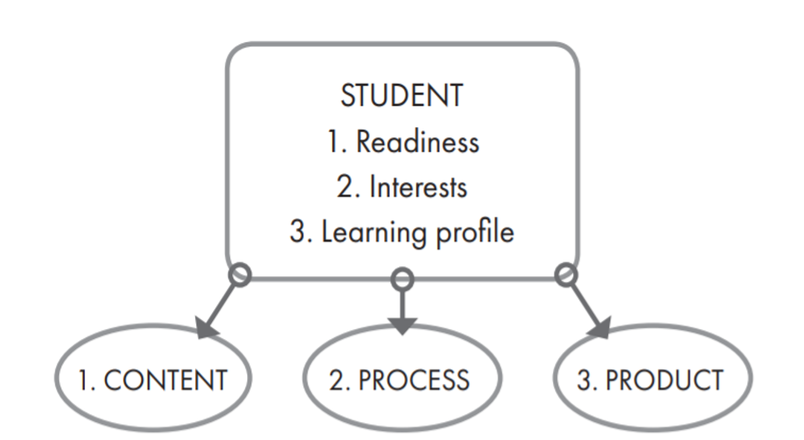
Previous models for differentiation
Tomlinson (2014)
content = what students are expected to learn (e.g. teaching materials)
process = how students’ learning is confirmed (e.g. teaching methods)
product = how students demonstrate their learning (e.g. assessment)

Slide 6
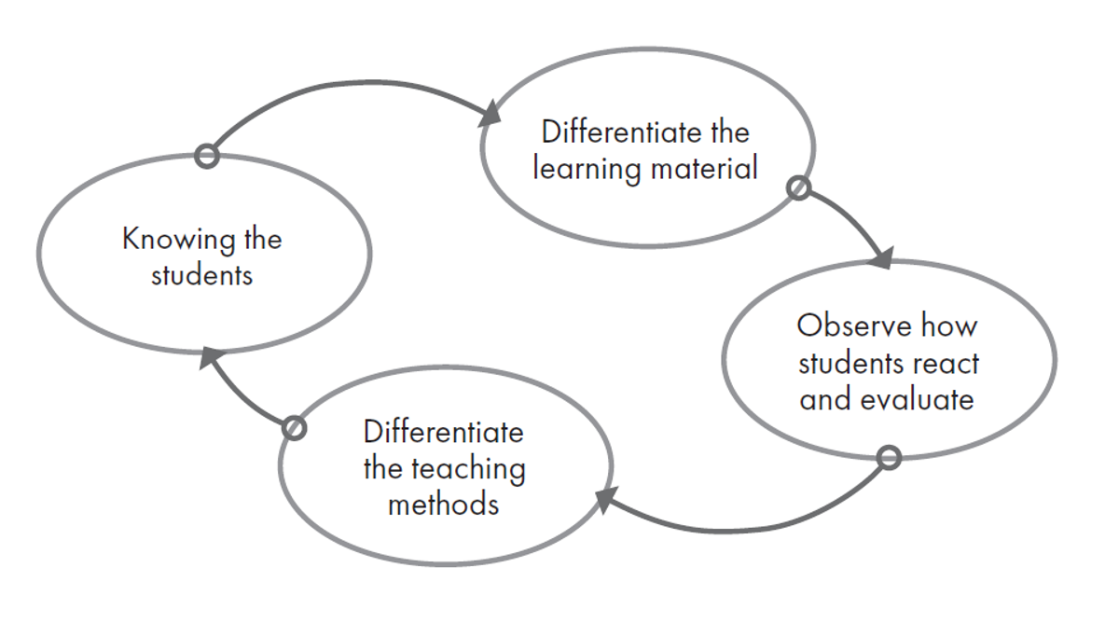
The proactive model of differentiation
Thousand, Villa & Nevin (2007)

Slide 7

Research results on differentiation
Deunk et al. (2018) meta-analysis (n=21)
  differentiation has a positive effect when implemented extensively
  using ICT in differentiation has a positive effect
Graham et al. (2021)
  differentiated teaching more beneficial to pupils’ learning
  than teaching without differentiation
Puzio et al. (2020)
  differentiation effective in teaching reading skills in primary schools
Smale-Jacobse et al. (2019)
  differentiation positive effects on students’ academic performance in secondary school
McCrea Simpkins et al. (2009); Karadag & Yasar (2010); Roy et al. (2015)
  Positive effect on motivation and self-concept

Slide 8

Differentiation is found challenging
What are the greatest challenges to implement differentiation in your own context?

Slide 9
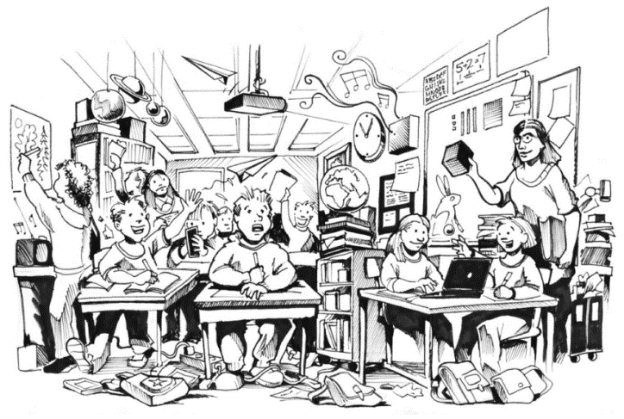
Challenges of differentiation
large class sizes
time constraints
impractical physical environment
materials
lack of knowledge of effective methods
lack of resources
lack of collaborative planning time
lack of administrative support
(e.g. Gaitas & Martins, 2017; Roiha, 2014; Roiha et al. 2023; Shareefa et al., 2019; Tomlinson & Imbeau, 2010; Wan, 2017)

Slide 10
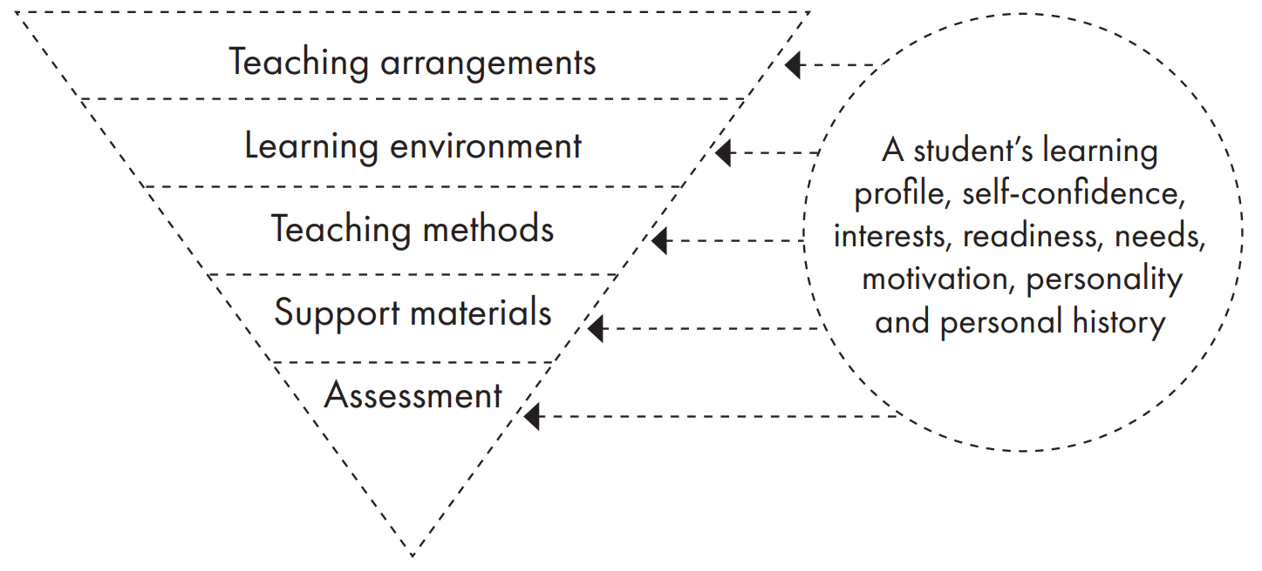
5-Dimensional (5D) model of differentiation (Roiha & Polso, 2020)

Slide 11
The Finnish national core curriculum
Finnish National Agency for Education (2014)
The selection of working methods is guided by differentiation of instruction. Differentiation is based on the teacher’s knowledge of their pupils’ personal needs. It is the pedagogical point of departure for all instruction. It concerns the extent and depth of learning, the rhythm and progress of the work and the pupils’ different ways of learning. Differentiation is based on the pupils’ needs for and possibilities of planning their own studies, selecting different working methods and progressing at an individual pace. The individual and developmental differences between pupils are also taken into account in the selection of working methods. Differentiation supports the pupils’ self-esteem and motivation and promotes a peaceful setting for learning. Differentiation also pre-empts needs for support.
The Finnish National Core Curriculum for Basic Education (2014)

Slide 12

Flexible grouping
Co-teaching
Remedial teaching
Additional teaching
Paralleling lessons
Learning assistant
Part-time special needs education
Split lessons
Temporary shortening the school day
Genius hour -arrangement

Slide 13

Flexible grouping
pupils are grouped temporarily based on different criteria: ability, learning styles, social relations, interests
can be implemented within or across classes (and grade levels)

Slide 14

Research on flexible grouping
Positive impact on learning for pupils in primary schools:
Dubé et al. (2013): in reading comprehension
Castle et al. (2005): in reading and writing
Jecks (2011): in reading skills
Differentiating according to different learning styles may also support classroom management
(Rytivaara, 2011)

Slide 15
Examples of flexible grouping
Flexible grouping within class
Pupils are divided into 3 groups based on different criteria
(ability, interests, etc.)
Each group works on a given activity for ca. 15 minutes at a time
  1 group works under teacher’s guidance on e.g. grammar
  1 group reads a text in the target language and does exercises on it
  1 group works on online exercises in the target language

Slide 16
Examples of flexible grouping
  Flexible grouping across classes (oral communication)
  One hour a week for the arrangement
  Pupils are divided into groups flexibly, on the basis of their ability but also at times based on their interests
  Two teachers support and guide the groups
  Teacher can support both low- and high-achievers
  Affective factors will be acknowledged

Slide 17
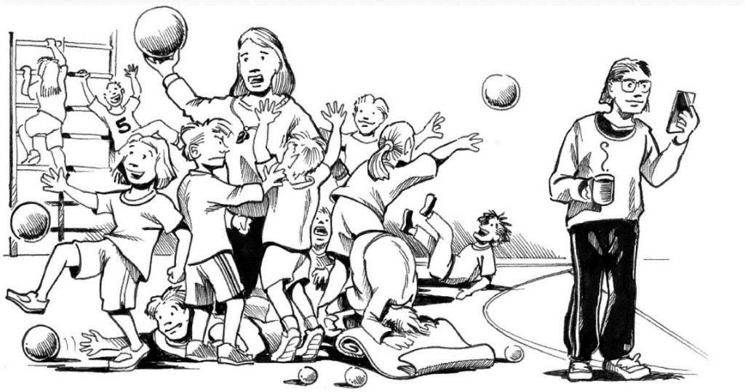
Co-teaching
1. Supportive teaching
2. Parallel teaching
3. Complementary teaching
4. Team teaching
Thousand, Villa & Nevin (2006)
On Co-Teaching, see also University of Zagreb’s OER on ConnEcTEd project website

Slide 18
Co-teaching
1. Supportive teaching
The other teacher has main responsibility about giving instructions to the class, while the other teacher works among the students to give individual and targeted support.
For example, in foreign language class, one teacher can teach something from the front of the class, while the other teacher instructs the same thing in more detail to those who need support.

Slide 19
Co-teaching
2. Parallel teaching
Both teachers are simultaneously instructing a part of the class in different areas of the classroom.
The teachers can be responsible for their group for the whole lesson, or the groups can switch stations halfway through the lesson. In the latter case, the teachers would teach the same thing to both groups.

Slide 20
Co-teaching
3. Complementary teaching
One of the teachers has main responsibility for teaching the whole class, while the other teacher simultaneously fills in the gaps and makes the teaching more diversified. This model differs from supportive teaching in that the complementary teacher is also addressing the whole class, instead of a few specific students.
For example, one teacher can teach something in front of the class, while the other writes down notes on the board for the whole class. Alternatively, the role of the complementary teacher can be to specify or to clarify the instruction of the other teacher.

Slide 21
Co-teaching
4. Team teaching
Teachers plan, execute, and assess teaching together. Teachers are both equally responsible for the course of the lesson and the learning of the students.
For example, teachers can instruct the whole class one after the other, while the other assumes a more supportive role. In this mode, teachers can smoothly use their specialisation.
For example, in a foreign language class, the teacher who has better command of the language can teach grammar, while the other teacher, more specialised in music, can teach an educational song to the group to support the learned topic. The roles of the teachers are equal in team teaching, and the students see both teachers as one another’s equivalent.

Slide 22
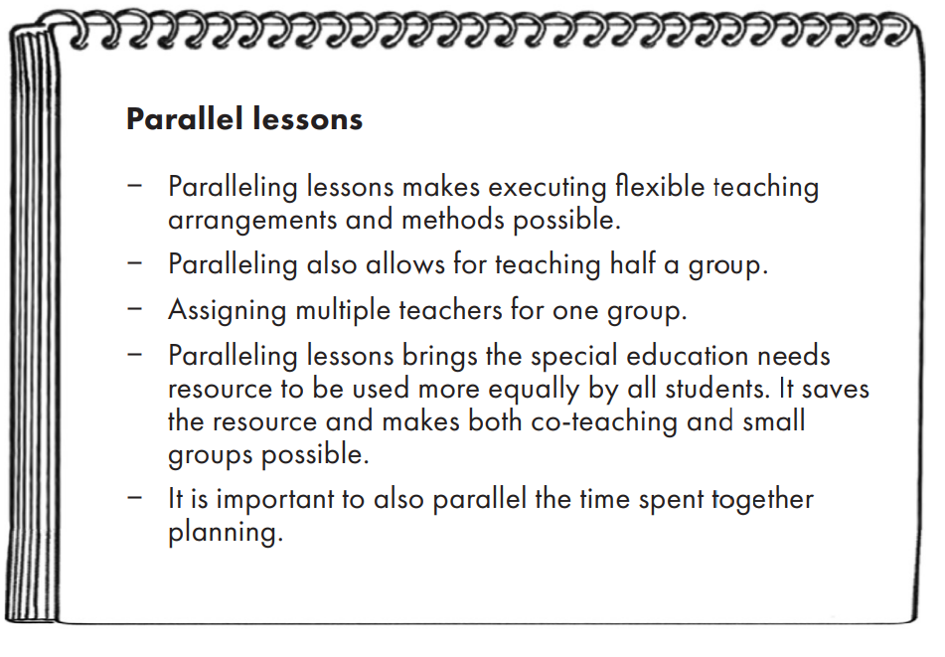
Paralleling lessons
Situating lessons in the same place in the schedule for two or more teachers > enables co-teacher, special needs resources

Slide 23

Genius hour
1 lesson per week dedicated to this arrangement
pupils work on topics of their interest either alone or in pairs/groups
topics are broad and require inquiring and problem-solving
pupils plan their work and make goals for themselves (long-term and short-term)
Examples of Genius hour topics:
  learning about black holes
  learning about climate change
  learning how to code
  learning to speak Spanish
  learning Braille writing
  making a movie
  creating one’s own dance

Slide 24

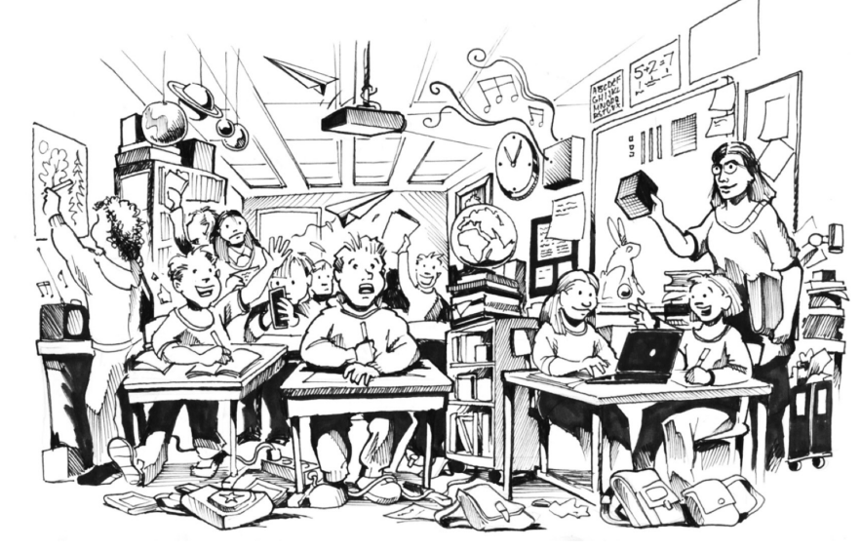
Physical
  flexible > desks and furniture can be moved as needed
  organized and systematic > named places for all items
  different working spaces > silent work, group work
  seating arrangements
  different classes equipped differently
  > one has ICT emphasis, one group work etc.
  differentiate visual materials and reduce extra stimuli
Psycho-social
  the atmosphere in the classroom > grouping, pair and group work
  varying groups
  free moments and transitions

Slide 25

The principles of differentiated teaching
  teaching study skills
  giving instructions
  allowing individual progress
  differentiating homework (amount, type, same homework for a longer period of time, no homework, pupils get to choose their own homework)
  structure in teaching (clear structure, organisation and permanence)
  differentiating learning materials (different use, individual material,
  different grade level material)

Slide 26
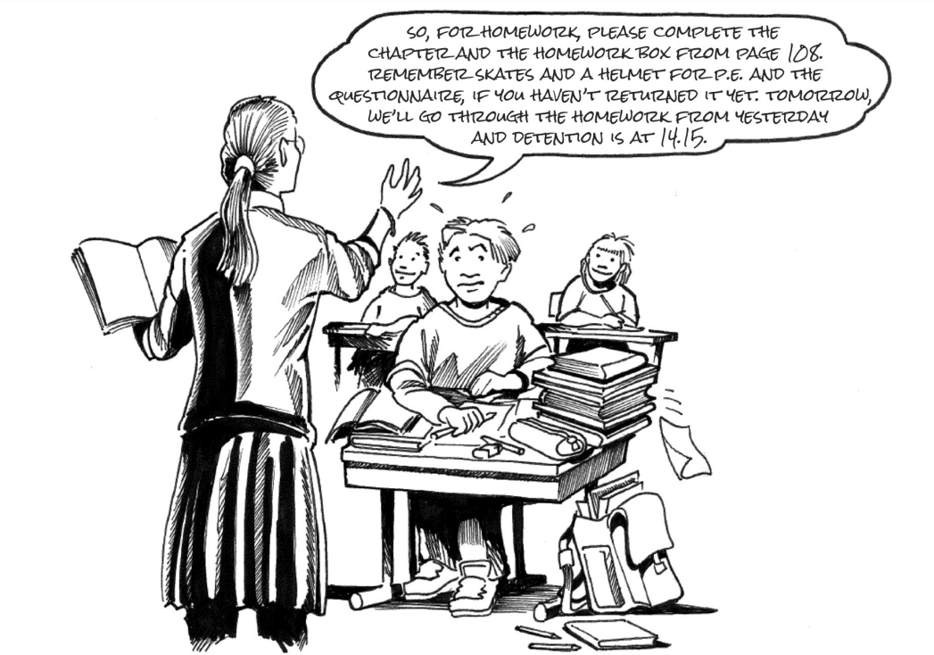
Differentiated
teaching methods
independent work
(individual progress & support material)
contractual project work
(certain goals and content for the unit and pupils get to choose in which order they complete them and on which topics to focus)
station work
project work

Slide 27
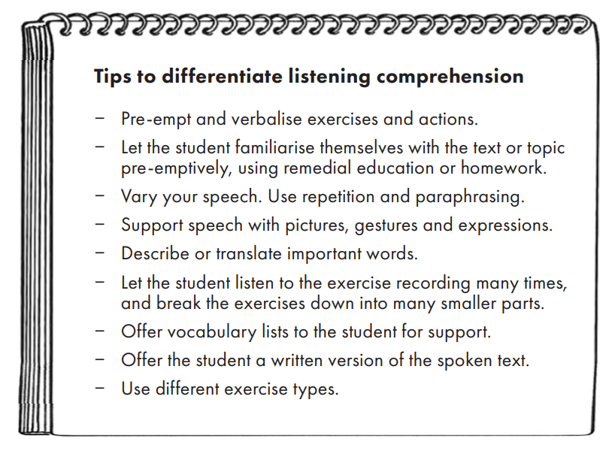
Tips to differentiate listening comprehension
Roiha & Polso (2020)

Slide 28
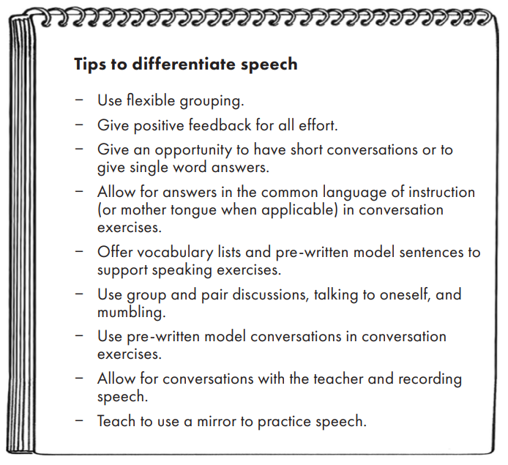
Tips to differentiate speech
Roiha & Polso (2020)

Slide 29
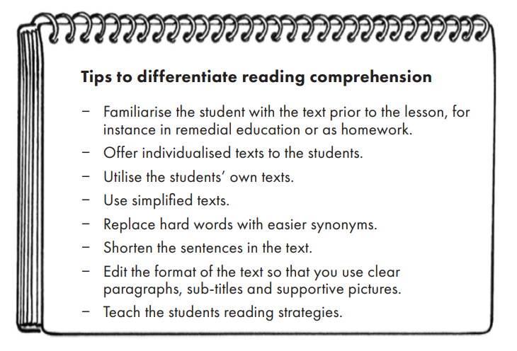
Tips to differentiate reading comprehension
Roiha & Polso (2020)

Slide 30
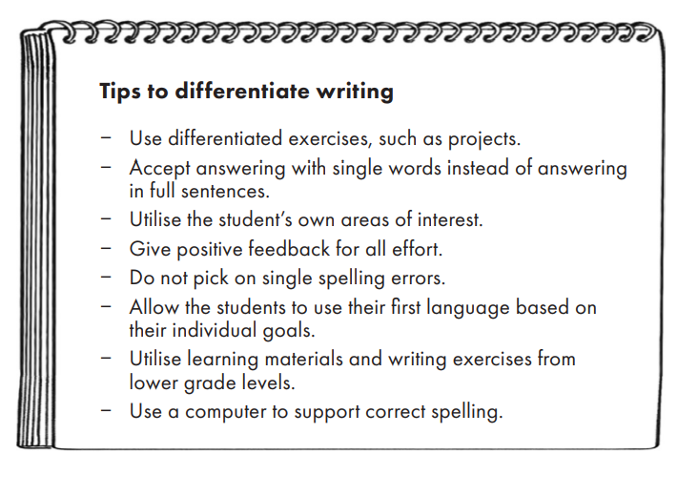
Tips to differentiate writing
Roiha & Polso (2020)

Slide 31

A plethora of different support material in the classroom
Making use of ICT
  audiobooks
  increasing font size, increasing spaces between words
  underlining, highlighting
  printing on coloured paper
  online exercises
  translation programmes
  making notes with a computer or tablet
  recording speech
  writing with Word

Slide 32
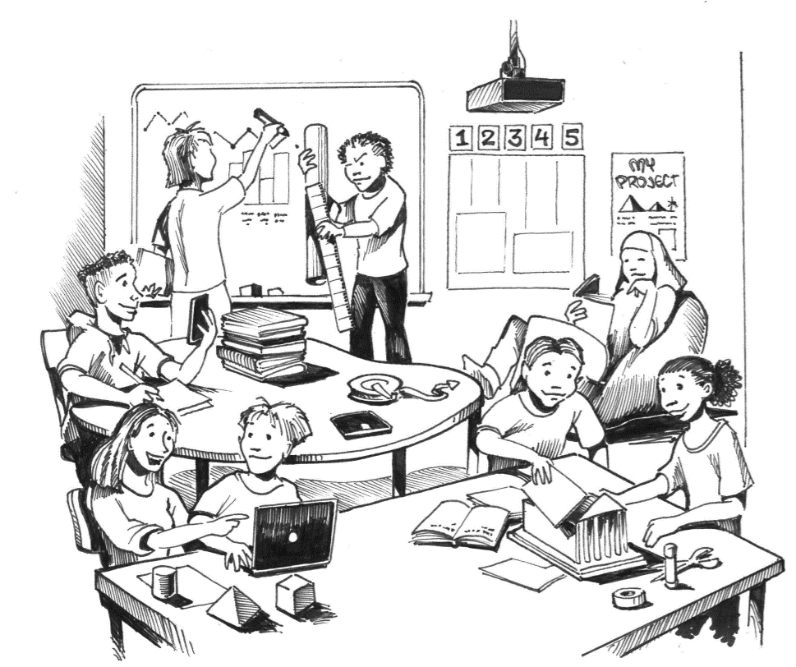
Tools to concentrate
  noise-cancelling headphones, earplugs, listening to music
  wearing a hood and cap
  partitions
  seating cushions, gym balls
  objects to fiddle with: blu tack, stress ball, bean bag chair
  allowing the pupils to draw
  structuring work: hourglass, Time Timer clock, egg timer

Slide 33
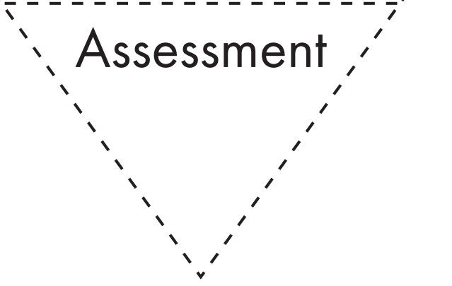
When the purpose of assessment is to see what the student knows and how the student learns before the content is taught, this is called pre-assessment. Sometimes this is also referred to as diagnostic assessment. The purpose of pre-assessment is to figure out what the student knows and can do, in order to tailor teaching according to their needs. For example, with a new class, or a new student joining a pre-existing class, the teacher should carefully become familiar with their background and potential transcripts. In addition, for example in mathematics or language and literature, one can hold a baseline test to find out what the student’s initial skills are. This directs instruction and its differentiation. Pre-assessment can also be used as an aid to differentiation, for example when planning teaching groups. Pre-assessment also helps the student to connect what they already know with what they are about to learn.
pre-assessment
formative assessment
summative assessment
When the knowledge of a student is assessed in the end of a period of study, we talk about summative assessment. Summative assessment should make visible what the student has learned, and it must consist of learning objectives, content and teaching methods. Even summative assessment does not have to be written. Summative assessment can also be made in a group or individually.
When the knowledge of a student is assessed in the end of a period of study, we talk about summative assessment. Summative assessment should make visible what the student has learned, and it must consist of learning objectives, content and teaching methods. Even summative assessment does not have to be written. Summative assessment can also be made in a group or individually.

Slide 34
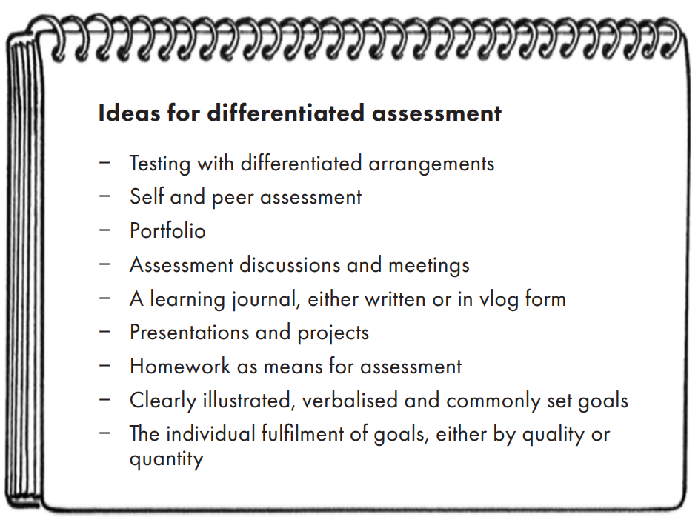

Slide 35
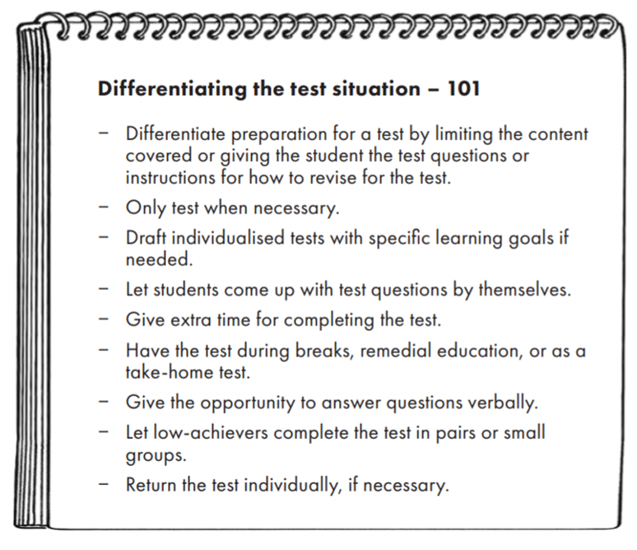
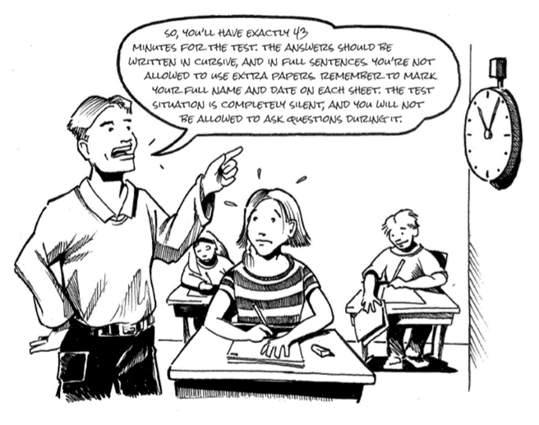

Slide 36
How to recognize the need for differentiation?
Differentiation always stems from the pupils and their individual needs > knowledge of one’s pupils is essential
  discussions with the pupil and their guardians
  discussions with colleagues (classteacher, subject teacher, special needs teacher)
  consultations with former teachers (with the permission of the guardians)
  engaging with the pedagogical documents of the pupils
  old exams, self-assessments and tests
  consulting the school psychologist anonymously
  feel free to try out different ways! (trial and error)

Slide 37
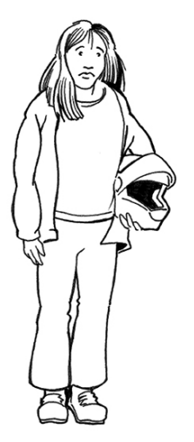
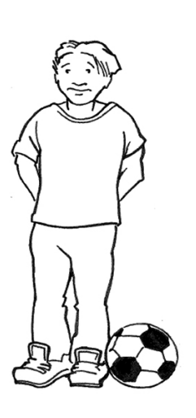
Exercises
Next, two cases are presented.
Please read them through and think about differentiation:
How would you support the learning of Sam and Catherine?

Slide 38
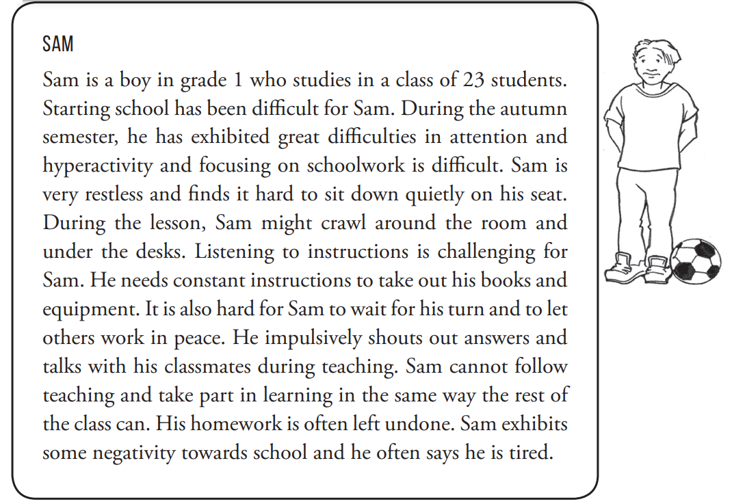
Initial scenario

Slide 39
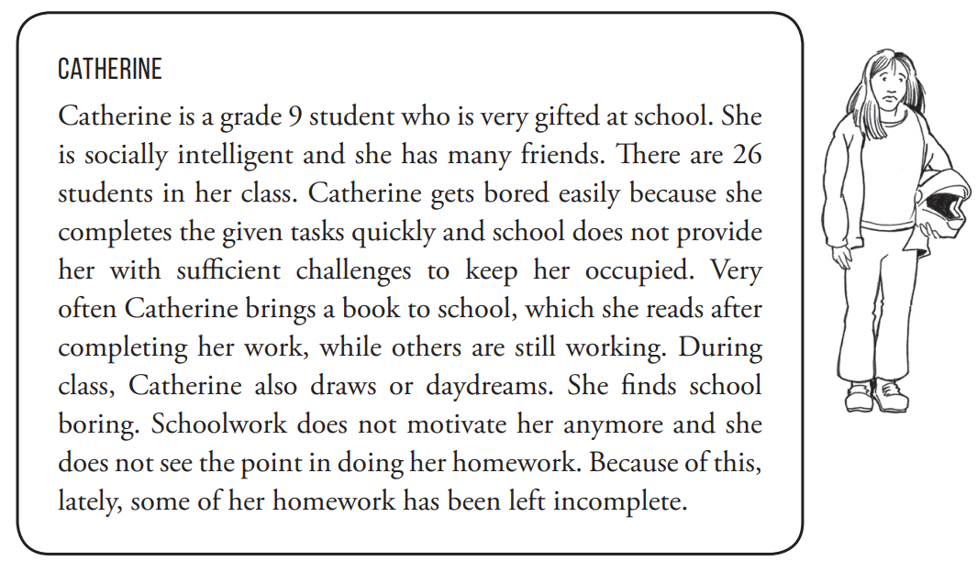
Initial scenario

Slide 40
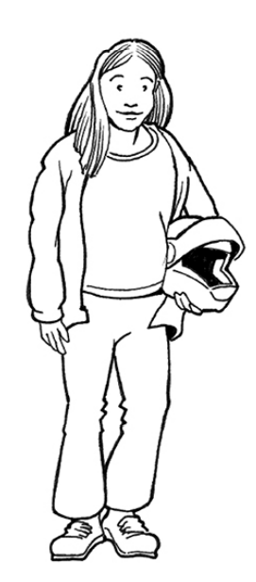
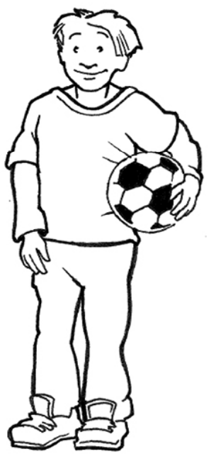
How to get started with differentiation –concluding words
Start small > from one dimension and gradually build up from there
Start with a colleague
Differentiation needs resources > policymakers
Administrative support is vital > differentiation as part of
mission statements and curricula
Share ideas and good practices at school
Involve the guardians in differentiation
Differentiation is a whole school approach!
Differentiation is a mindset and a way of looking at things!

Slide 41
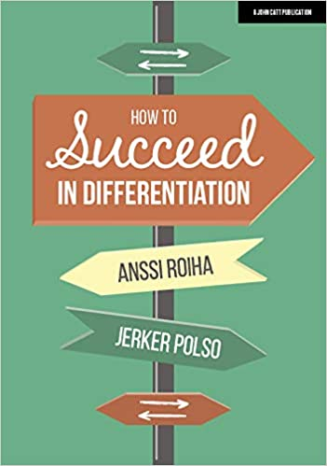
Further reading on the 5D model
Roiha, A., & Polso, J. (2020). How to succeed in differentiation. The Finnish approach. Woodbridge: John Catt Educational Ltd. https://www.johncattbookshop.com/how-to-succeed-in-differentiation
Roiha, A., & Polso, J. (2021). The 5-Dimensional Model: A Finnish approach to differentiation. In D. L. Banegas, G. Beacon & M. Pérez Berbain (Eds.), International perspectives on diversity in English language teaching (pp. 211–227). Palgrave Macmillan.
Roiha, A., & Polso, Jerker (2021) The 5-dimensional model: A tangible framework for differentiation. Practical Assessment, Research, and Evaluation, 26, Article 20. Available at: https://scholarworks.umass.edu/pare/vol26/iss1/20
Roiha, A., Boerma, N., & Ballester, M. (2021). Differentiation. In A. Roiha & E. Wiseman (Eds.), Teaching and learning in international schools: Lessons from primary practice. St Albans: Critical Publishing, 19–35.
Laari, A., Lakkala S., & Uusiautti, S. (2021). ‘For the whole grade’s common good and based on the student’s own current situation’: Differentiated teaching and the choice of methods among Finnish teachers. Early Child Development and Care, 191(4), 598–611.

Slide 42
Further reading on differentiation in general
Tomlinson, C.A. (2017). How to Differentiate Instrcution in Academically Diverse Classrooms. Alexandria, Va.: ASCD.
Tomlinson, C.A. & Imbeau, M.B. (2010). Leading and managing a differentiated classroom. Alexandria, Va.: ASCD.
Tomlinson, C.A. (2014). The differentiated classroom: responding to the needs of all learners. 2nd edition. Alexandria, Va.: ASCD.

Slide 43
References
Benjamin, A. (2002). Differentiated instruction: A guide for middle and high school teachers. Larchmont, NY: Eye on Education.
Castle, R., Baker Deniz, C. & Tortora, M. 2005. Flexible grouping and students’ learning in a highneeds school. Education and Urban Society 37 (2), 139–150.
Deunk, M. I., Smale-Jacobse, A. E., de Boer, H., Doolard, S. & Bosker, R. J. (2018). Effective differentiation practices: A systematic review and meta-analysis of studies on the cognitive effects of differentiation practices in primary education. Educational Research Review 24, 31–54.
Dubé, F., Dorval, C. & Bessette, L. 2013. Flexibles grouping, explicit reading instruction in elementary school. Journal of Instructional Pedagogies 10, 1–12.
Finnish National Core Curriculum for Basic Education (2014). Helsinki.
Gaitas, S. & Martins, M. A. 2017. Teacher perceived difficulty in implementing differentiated instructional strategies in primary school. International Journal of Inclusive Education 21 (5), 544–556.
Graham, L., de Bruin, K., Lassig, C. & Spandagou, I. 2021. A scoping review of 20 years of research on differentiation: investigating conceptualisation, characteristics, and methods used. Review of Education 9 (1), 161–198.
Hall, T. (2002). Differentiated instruction. Wakefield, MA: National Center on Accessing the General Curriculum.
Jecks, D. (2011). Flexible Skills Grouping of Elementary Students for Reading Instruction: A Meta-analytic Review. Western Illinois University ProQuest Dissertations Publishing.
Karadag, R. & Yasar, S. (2010). Effects of differentiated instruction on students’ attitudes towards Turkish courses: an action research. Procedia – Social and Behavioral Sciences 9, 1394–1399.
Lindner, K.-T. & Schwab, S. (2020). Differentiation and individualisation in inclusive education: A systematic review and narrative synthesis. International Journal of Inclusive Education. DOI: 10.1080/13603116.2020.1813450
McCrea Simpkins, P., Mastropieri, M. A. & Scruggs, T. E. (2009). Differentiated curriculum enhancements in inclusive fifth-grade science classes. Remedial and Special Education 30 (5), 300–308.
Pozas, M., Letzel, V. & Schneider, C. (2020). Teachers and differentiated instruction: exploring differentiation practices to address student diversity. Journal of Research in Special Educational Needs 20 (3), 217–230.
Puzio, K., Colby, G. T. & Algeo-Nichols, D. (2020). Differentiated literacy instruction: Boondoggle or best practice? Review of Educational Research 90 (4), 459–498.

Slide 44
Roiha, A. (2014). Teachers’ views on differentiation in content and language integrated learning (CLIL): perceptions, practices and challenges. Language and Education 28 (1), 1–18.
Roiha, A., Nieminen, J. & Mäntylä, K. 2023. Lukion vieraiden kielten opettajien käytänteitä ja käsityksiä eriyttävästä arvioinnista. Teoksessa T. Mäkipää, R. Hilden & A. Huhta (toim.) Kielenoppimista tukeva arviointi. AFinLA-teema.
Roiha, A., & Polso, J. (2020). How to succeed in differentiation: The Finnish approach. John Catt.
Roiha, A. & Polso, J. (2021). The 5-dimensional model: A tangible framework for differentiation. Practical Assessment, Research & Evaluation 26 (20), Article 20.
Roy, A., Guay, F., & Valois, P. (2013). Teaching to address diverse learning needs: Development and validation of a differentiated instruction scale. International Journal of Inclusive Education, 17(11), 1186–1204.
Roy, A., Guay, F., & Valois, P. (2015). The big-fish–little-pond effect on academic self-concept: The moderating role of differentiated instruction and individual achievement. Learning and Individual Differences, 42, 110–116.
Rytivaara, A. 2011. Flexible grouping as a means for classroom management in a heterogeneous classroom. European Educational Research Journal 10 (1), 118–128.
Saloviita, T. (2018). How common are inclusive educational practices among Finnish teachers? International Journal of Inclusive Education 22 (5), 560–575.
Shareefa, M., Moosa, V., Mat Zin, R., Abdullah, N. Z. M. & Jawawi, R. (2019). Teachers’ perceptions on differentiated instruction: Do experience, qualification and challenges matter? International Journal of Learning, Teaching and Educational Research 18 (8), 214–226.
Shulman, L. (1987). Knowledge and teaching: Foundations of the new reform. Harvard educational review, 57(1), 1–23. DOI: 10.17763/haer.57.1.j463w79r56455411.
Smale-Jacobse, A. E., Meijer, A., Helms-Lorenz, M. & Maulana, R. (2019). Differentiated instruction in secondary education: A systematic review of research evidence. Frontiers in Psychology 10, 2366.
Suprayogi, M. N., & Valcke, M. (2016). Differentiated instruction in primary schools: Implementation and challenges in Indonesia. PONTE, 72(6), 2–18.
Thousand, J. S., Villa, R. A., & Nevin, A. I. (2006). The many faces of collaborative planning and teaching. Theory into Practice, 45(3), 239–248.
Thousand, J. S., Villa, R. A., & Nevin, A. I. (2007). Differentiating instruction: Collaborative planning and teaching for universally designed learning. Thousand Oaks, C.A.: Corwin Press.
Tomlinson, C. A. (2014). The differentiated classroom: responding to the needs of all learners. 2. painos. Alexandria: ASCD.
Tomlinson, C. A. & Imbeau, M. B. (2010). Leading and managing a differentiated classroom. Alexandria: ASCD.
Wan, S. W. Y. (2017). Differentiated instruction: are Hong Kong in-service teachers ready? Teachers and Teaching, 23(3), 284–311.

