Slide 1


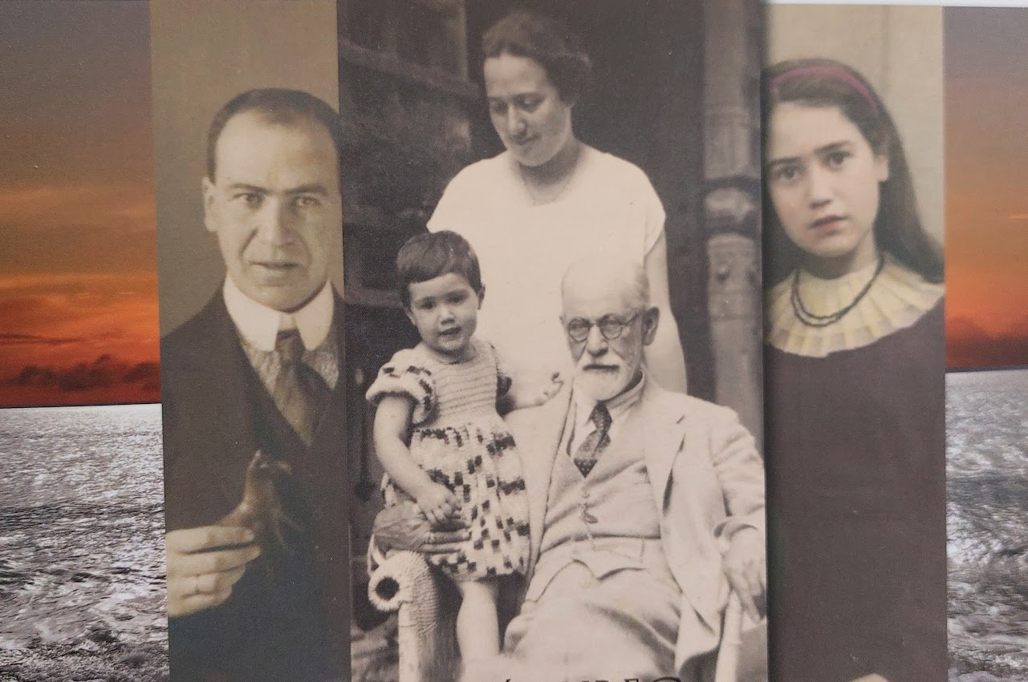
Eva Freud – a 20th century destiny
A transversale school collaboration projet as example of good practice​
​
ConnEcTEd 2021-22
Christine Schmider, Cindy de Smet (Université Côte d‘Azur, LINE), with the collaboration of Isabelle Sieurin, Philosophy Professor (Lycée Calmette, Nice)

Slide 2

1. The Project in the general context of teacher education and coherence
Measures of coherence Frames /Learning
environments
Expectances and objectives Methods / principles /
approaches
Collaborative and cooperative
learning Co-creativity
Transdisciplinary teaching and Competence diagnosis
learning
Feedback / evaluation
… …
Notes:
Bisher oft um einzelne tandem-partner
Nun tandem-gruppen bzw. tandem-kurse,
Partnertandems also im frame
Context objectives (students as learners

Slide 3
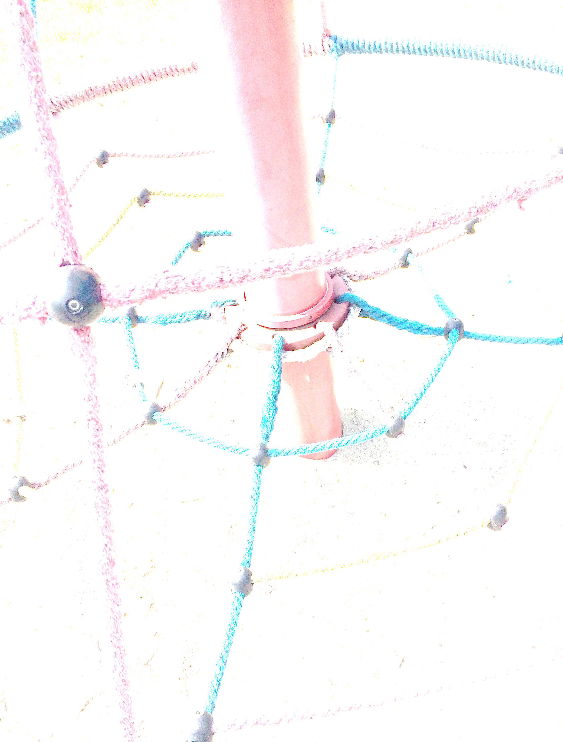
2. Context: Teacher ed students meet pupils
Educational context
  competence-based teacher ed…
  task-based…
  Out of school teaching
  School-uni cooperation : teach what you preach
Institutional context
  Upper secondary school class specializing in Humanities (HPL – Humanities, Philosophy, Literature)…
  Higher Education: binational teacher ed bachelor Nice-Freiburg

Slide 4
2.1 Educational Context
Foreign Language Education and Teacher Education since PISA (and DESI)…
  Competence-orientation
  The neo-communicative paradim and task-based language ed.
  (Meißner/Reinfried 2001, Ellis 2003, Königs 2012, Hallet 2016)
Changes in educational approaches and potential of out of school projects
  -> potential of cooperative and collaborative projets „out of school“
Notes:
Wie zusammenzubringen?

Slide 5
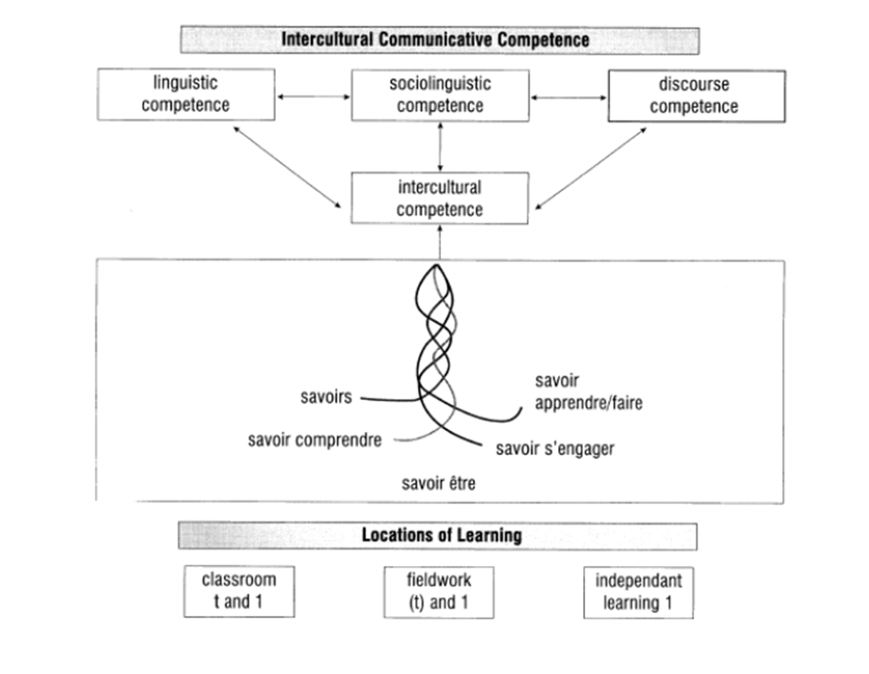

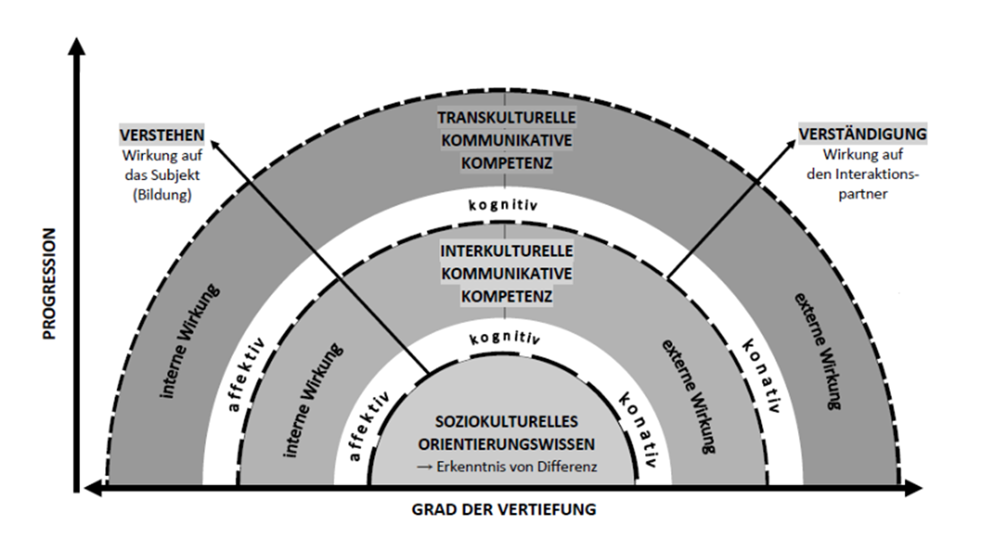
2.1 Competence-based education as measure of coherence?
What is „competence“ and „competence orientation“ in foreign language education?
Goal: inter/transcultural communicative competence In FLET– how?
Byram 1997
Reimann 2015
Notes:
What is competence , gumperz multimodal – plurilingual – intercultural – interactive plurilingual: coste, moore, zarate 1997 ; intercultural 97: knowledge, skills, attitudes, knowin ghow to learn (savoirs…)

Slide 6
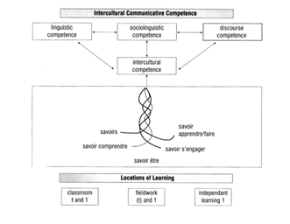
2.1 ICC / TCC as measure of coherence
Byram 1997
Notes:
Hymes 1972/1986 vs. Chomsky, integrative approach, competence and performance

Slide 7
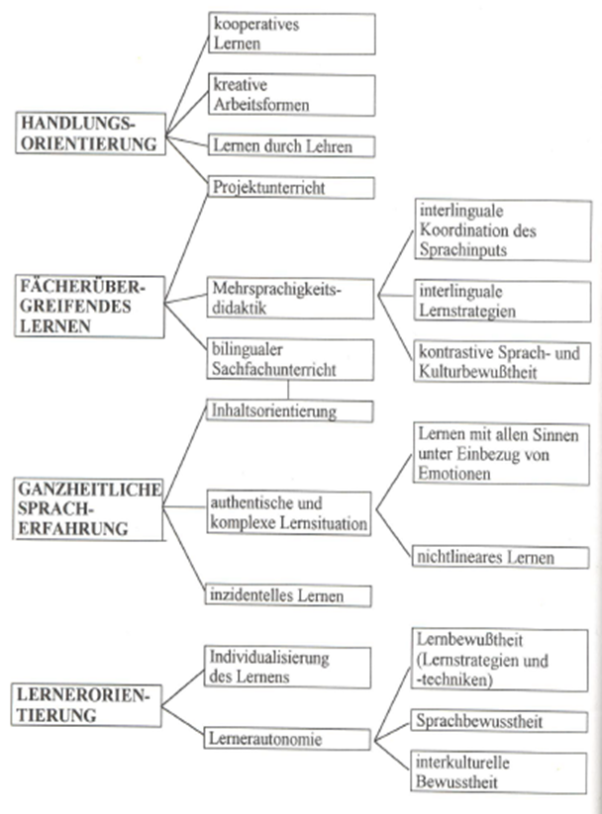
2.1 … how … in secondary education?
Task-based learning
Holistic / integrated learning experiences
Learner centered-ness
Reflection and self-regulation
(formative) feedback
GER 2001; Meißner / Reinfried 2001
Hattie 2013; De Florio-Hansen 2016
Meißner / Reinfried 2001

Slide 8
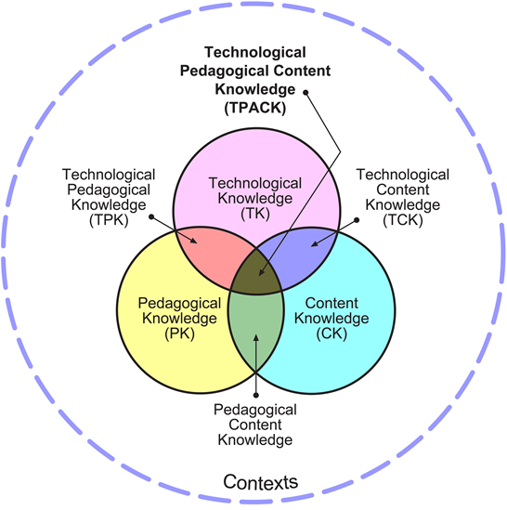
2.1 … in higher / teacher education?
… and what does that mean for teacher education?
Students as learners and (future) teachers
Key: reflective competence development (Schön 1983)
Not only in language classes, but across
the curriculum
  Reflective, integrated approach to ICC
  „Coherence“ between CK, PCK, PK & TPCK
  (Shulman 1987; Calsen 1988)

Slide 9
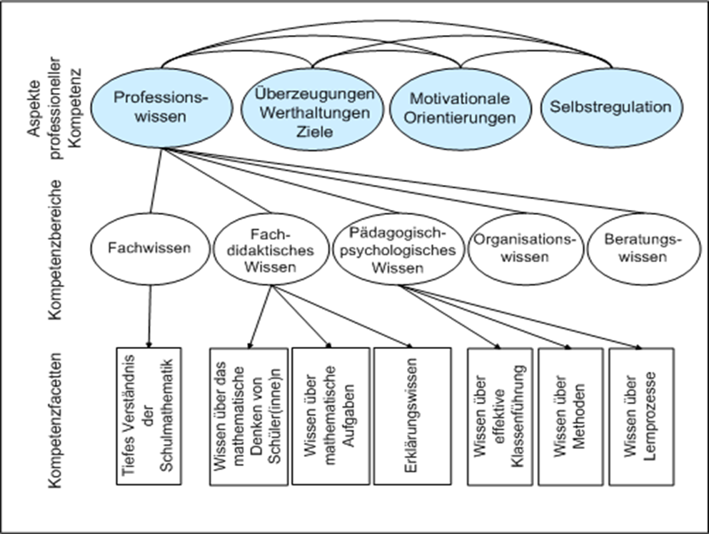
2.1… in higher / teacher education?
Teacher ed. / professionalisation
-> school achievement?
Competence and Performance in Teaching
Paradigms of „competence“
Coherence between theory and practice
Hammerness 2006; Blömeke 2008;
Baumert et al. 2008 / Coactiv

Slide 10
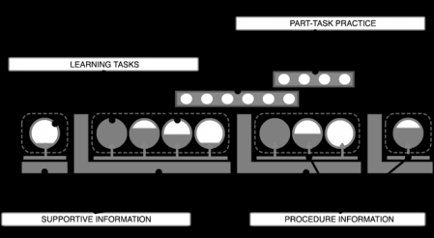
2.1 Task-based approach in FL Teacher Ed. as mesure of coherence
Complex learning task (Hallet 2011 / 2016)
  Meaning, relevance, topicality, complexity, openess, focus on learning processes…
4C/ID-model (van Merrienboer 1997 / 2007)
  Learning tasks
  Supportive information
  Procedural information
  (part-task practice)

Slide 11
2.1 Task based approach as measure of coherence
Competence-/Task-based approach
  Holistic, authentic, immersive learning and teaching situations in foreign language teacher education programmes
  Competence of „reflective practicioners“ (Schön 1983)
  Teach what you preach –coherence between learning and teaching
  Project oriented courses which foster relations and connections between different fields of the subject and theory and practice

Slide 12
2.1 Out of school project as measure of coherence
Out of school learning and teaching
  Practice related teaching
  Sustainable learning
  Making Learning material tangible
  Offering learning incentives (Salzmann, 2007)

Slide 13
2.1 School – Uni cooperation: Teach what you preach – vector of coherence
Teacher Ed students as learners and teachers
  Enhancing self reflection
  Developping professional awareness
  Sensibilizing for heterogeneity
  Questioning of their own teaching practice
  Changing of perspective
  Familiarizing with colaborative and cooperative teaching methods
  Gaining in confidence

Slide 14
2.2 Institutional context :Upper secondary school class specializing in Humanities (HPL Humanities, Philosophy,Literature)…
Pedagogical interest for the pupils
  Valorization of the their “Humanities, Literature and Philosophy” speciality through a creative and memorial project
  Enhancing the written competences through the writing of choruses and dialogues relating the life of Eva for the theatrical performance
  Exchanges with post-baccalaureate students in view of their orientation.
  Opening for students to academic work.
30 Pupils in « Terminale », (Upper School graduation Class), 4 hours à week, humanities profile

Slide 15
2.2 Institutional context : binational teacher ed students
Pedagogical interest for the students
  Project in collaboration with a French school - pre-professional experience
  Experience in project-based teaching approach that they will have to implement later in their own teaching
  sharing their linguistic, intercultural and pedagogical skills
  Reflecting on their own practice as learner and teacher
10 Students Binational german-french teaching degree in their 3rd Bachelor year.
Mixed german-french group, teaching experience (4 weeks), 2 year studies in their home country, on year mobility.

Slide 16
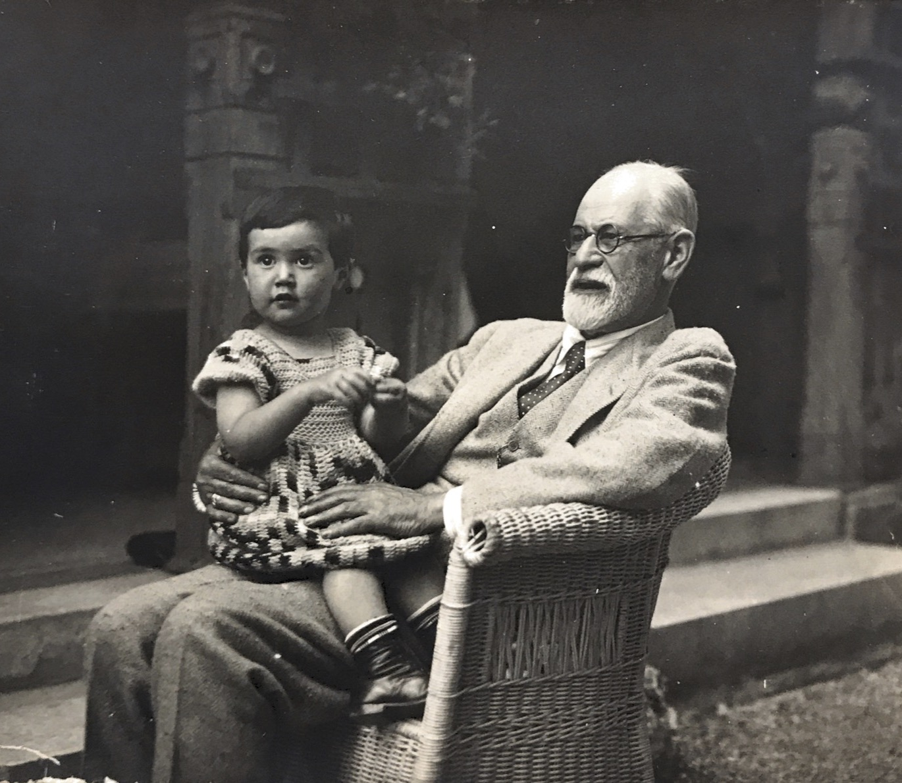
2.2 Presentation of the project. Objectifs, aims and themes
Biography and Scenic expression
  Reading and writing workshop on the correspondence of Eva Freud, Sigmund Freud’s granddaughter, a former student of the Lycée de Jeunes Filles, Calmettes de Nice during the Second World War.
  Writing texts, stage readings, work on selected letters in German and French
  Development of written expression through the writing of choruses and dialogues relating the life of Eva.

Slide 17
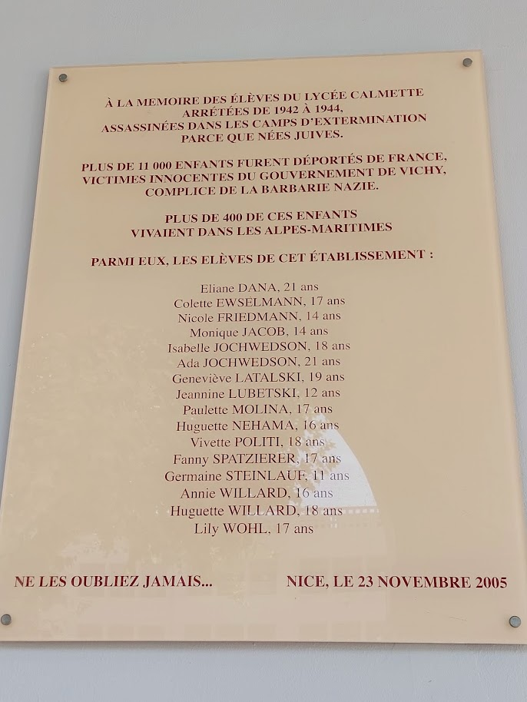
2.2 Presentation of the project. Objectifs, aims and themes
Cultural Studies and Memorial concepts
  Academic work on the topography of memory (Places of memory), the discourse of memory (sociological approaches, Maurice Halbwachs, Aleida Assmann, Harald Welzer), family memory, cultural memory)
  Understanding the Lycée Calmette as a place of remembrance for the children of the Alpes Maritimes who were deported and murdered in the Nazi death camps
  Enhancing critical historical thinking by learning how the knowledge of the past is built from traces, archives and testimonies.

Slide 18
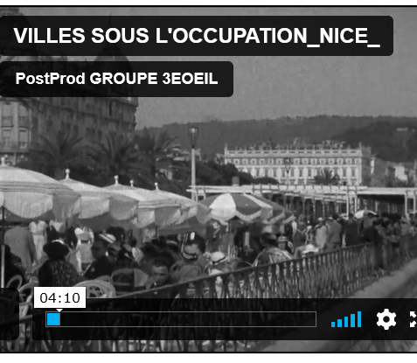
2.2 Presentation of the project. Objectifs, aims and themes
History and knowledge and awareness
  Learning about Nice as occupied zone
  Knowledge bout the French Riviera as place of refuge for refugee and exil communities
  Visiting Thorenc and searching for the traces of the hidden jewish refugees during 1942/43

Slide 19
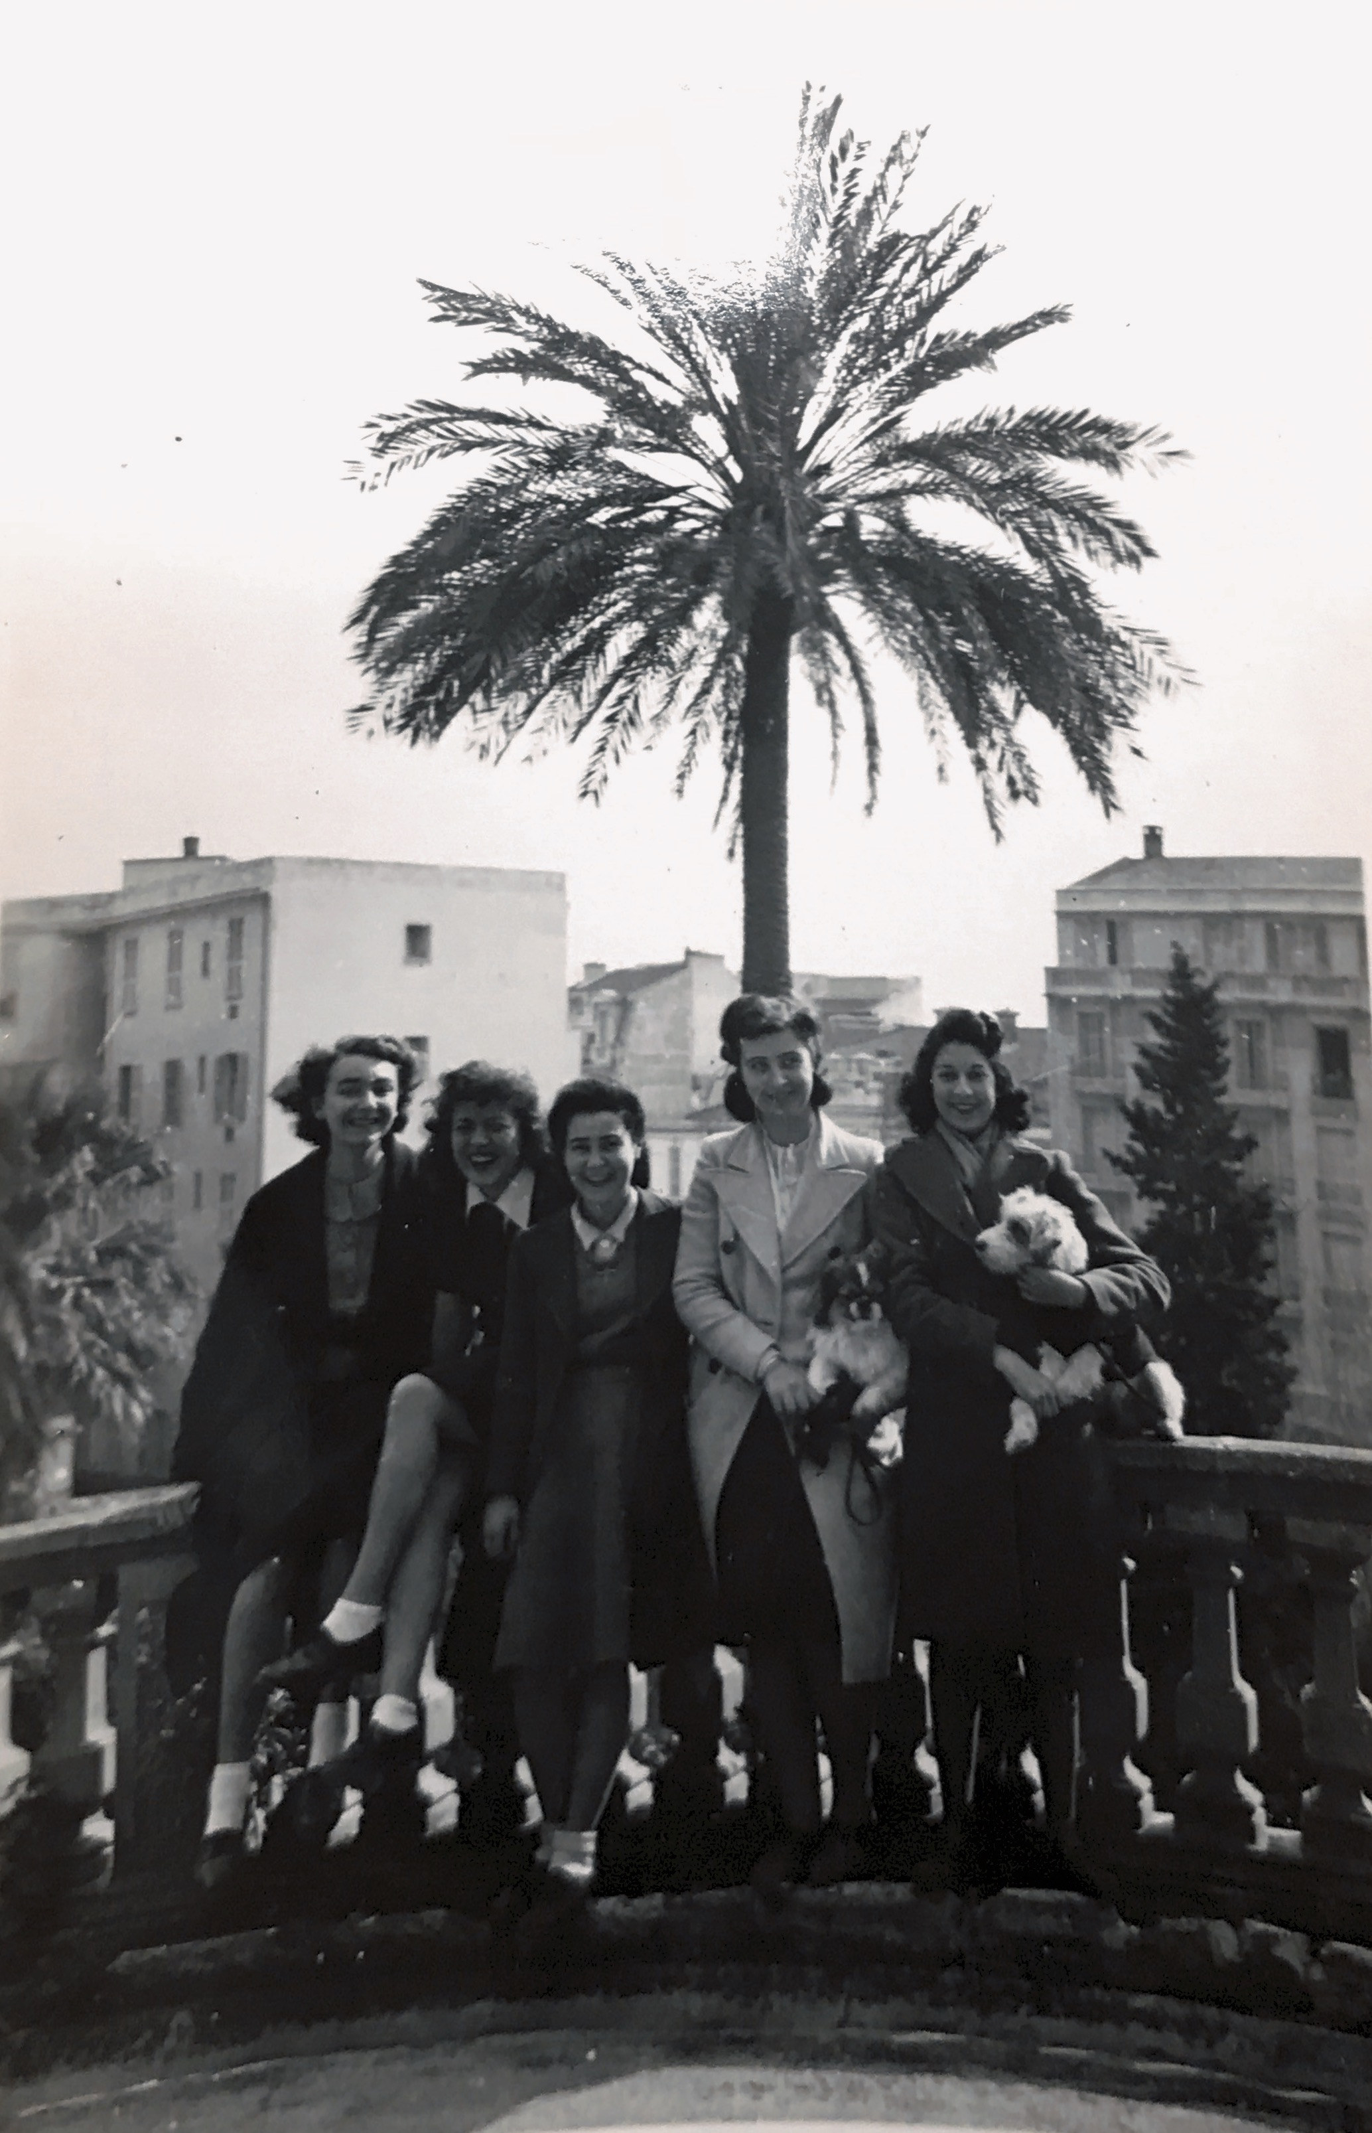
2.2 Presentation of the project. Objectifs, aims and themes
The female condition in the 1940s
  Researching the lives of young girls and women during Occupation
  Studying School live for girls in the 40s
  Learning about the abortion ban and its consequences

Slide 20
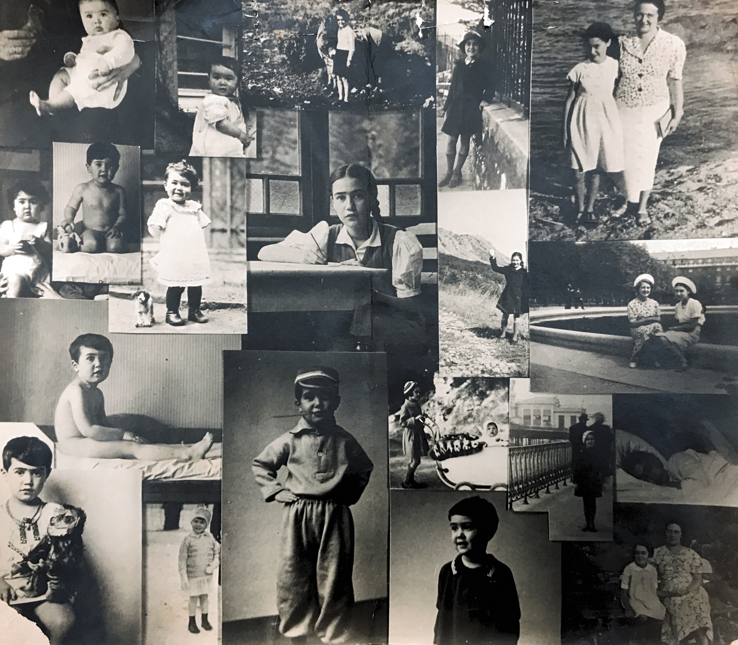
Final product
A theatrical performance based on the life and death of Eva Freud
2 representations:
At the theater of the “Grand Château” and at the German French Cultural Center

Slide 21
Eva Freud, a 20th century destiny
Powerpoint presentation for the students who participate in the
Projet
A collaborative School Project, 2022/23 LLCER 3
Littérature (HLECVL52), Histoire des idées (HLECVL52) et Expression écrite (HLECLL5), Mme Schmider/ Mme Sieurin

Slide 22


Slide 23
Who was Eva Freud?
Born on 3rd of september 1924 in Berlin
Sigmund Freud’s granddaughter
Came to Nice in 1934 after her family had to flee the rising nazism in Berlin
Pupil at Lycée Calmette Nice from 1934 till 1942
Died on 4th of november 1944 after an illegal abortiong

Slide 24
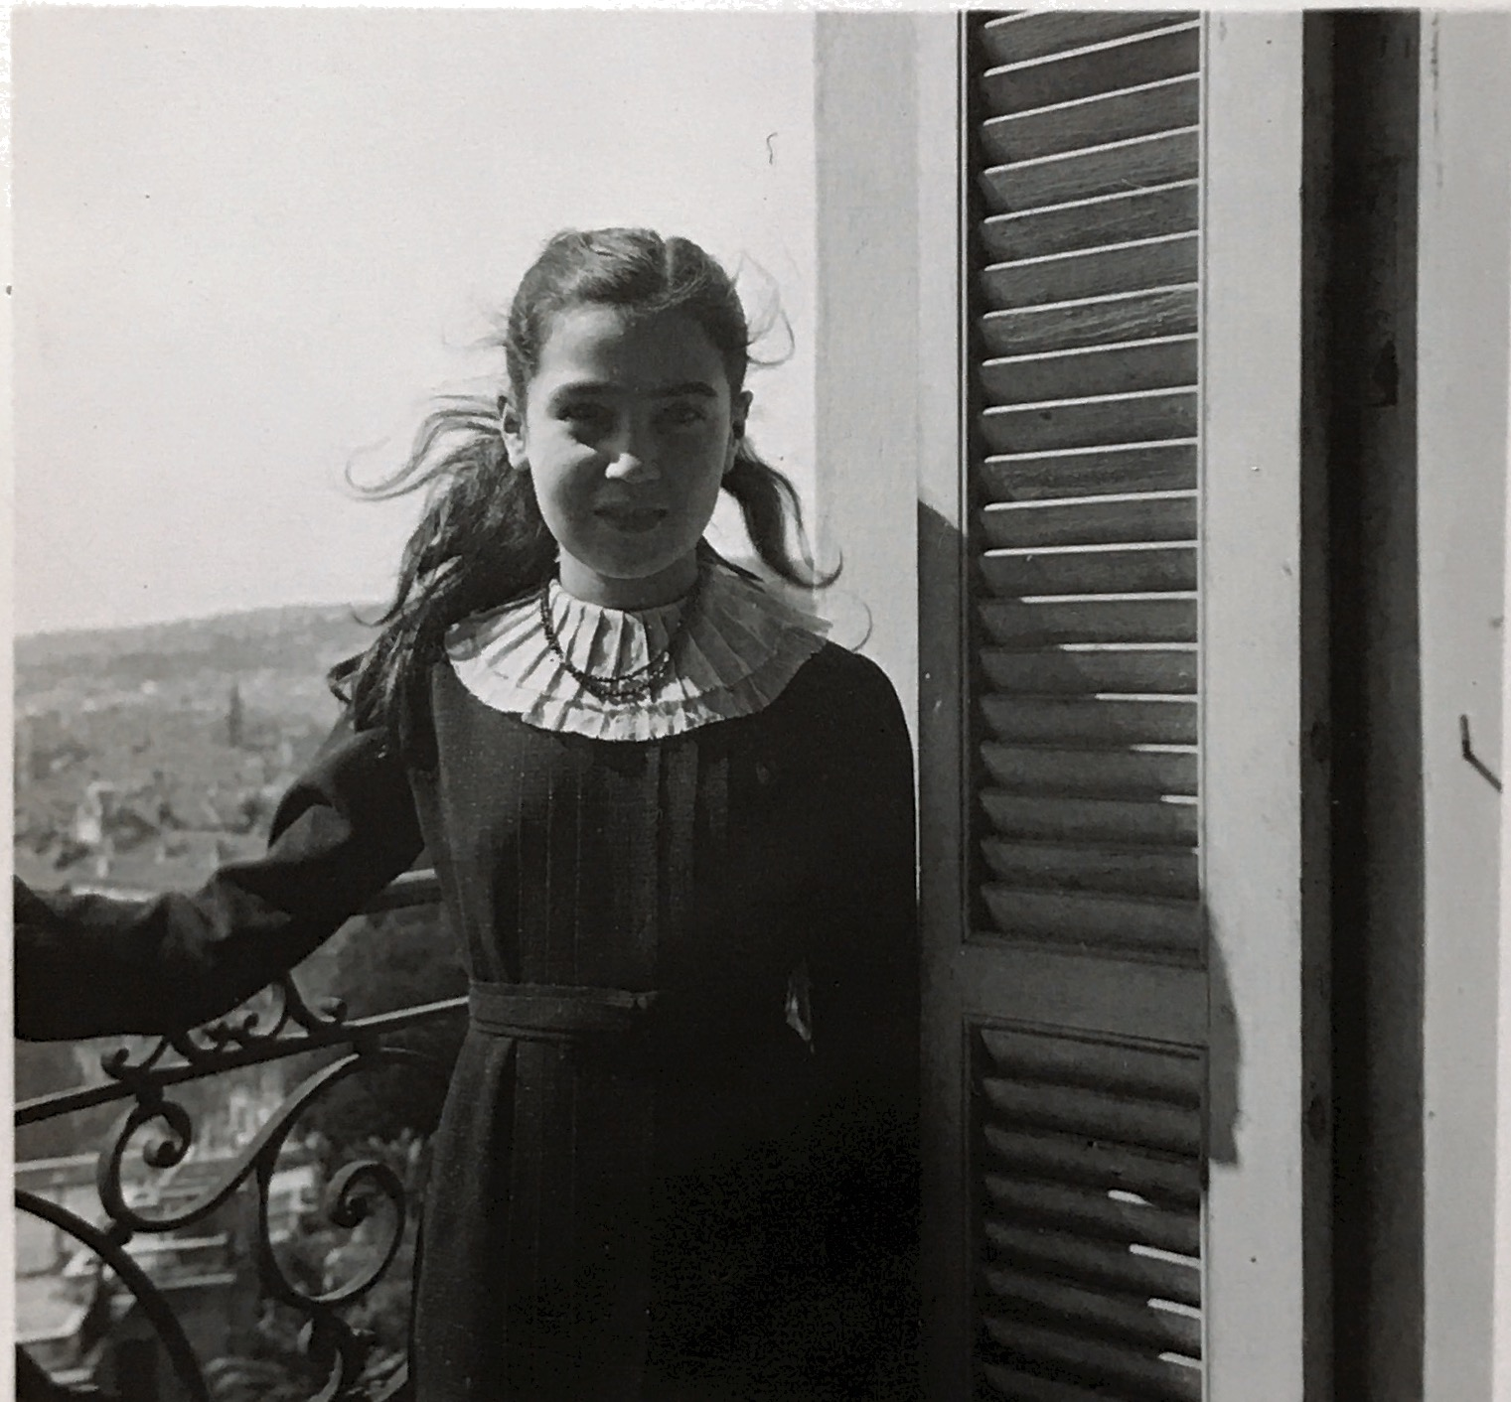
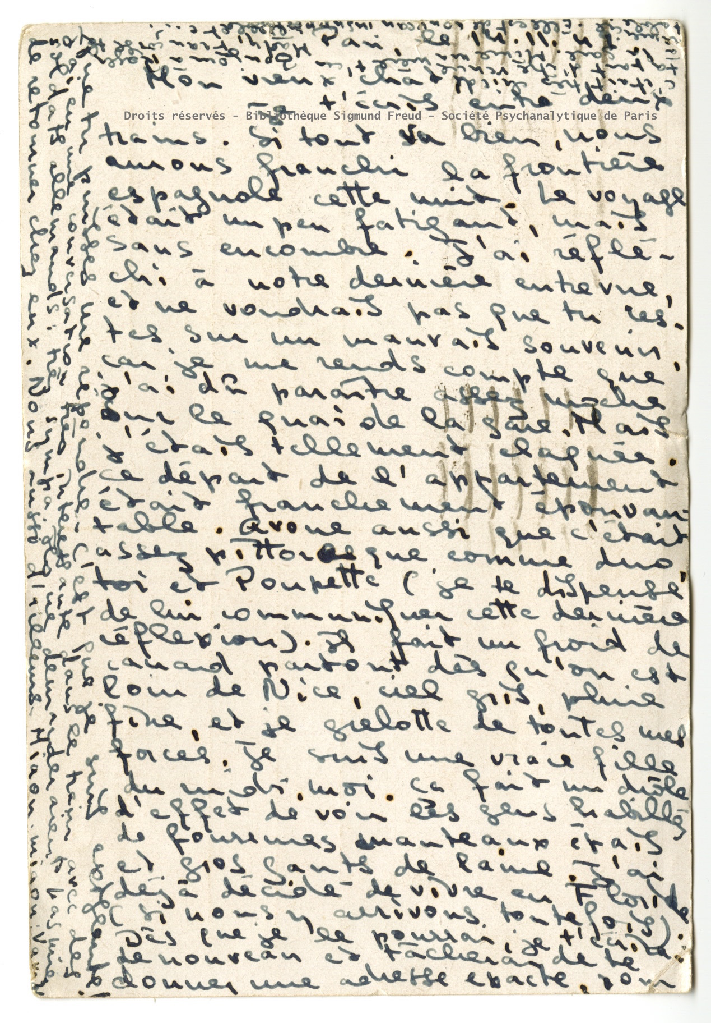
The Life of Eva Freud

Slide 25
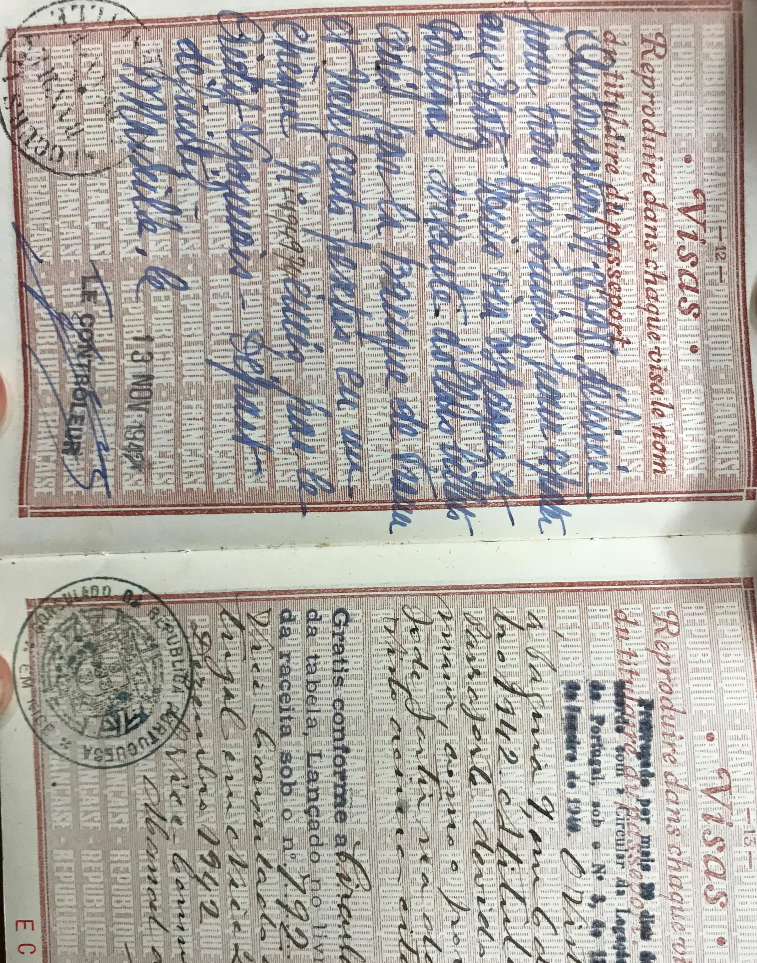
1. Why this project about Eva Freud?
Her live and death sheds light on:
The situation of the European Jews who were in exile in Nice, or on the French Riviera, during the occupation.
-Historical context National Socialism
-Persecution and exile of the European Jews

Slide 26
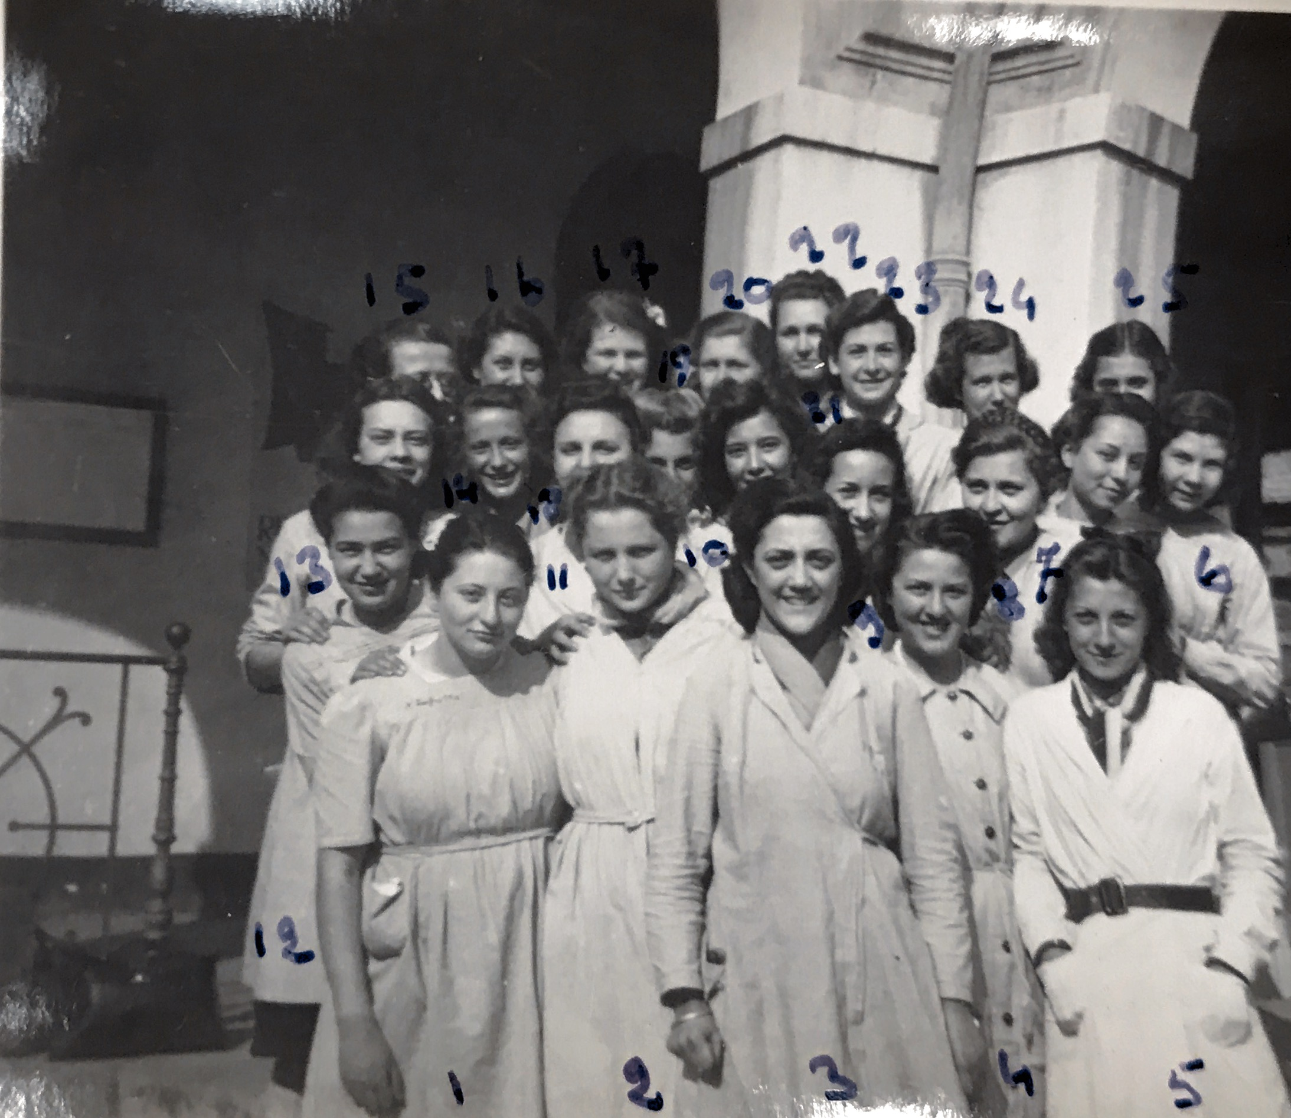
1. Why Eva Freud
Her live and death sheds light:
On the condition of young girls and women in the 1940s.
Female Condition
Abortion ban
School education in the 40s

Slide 27
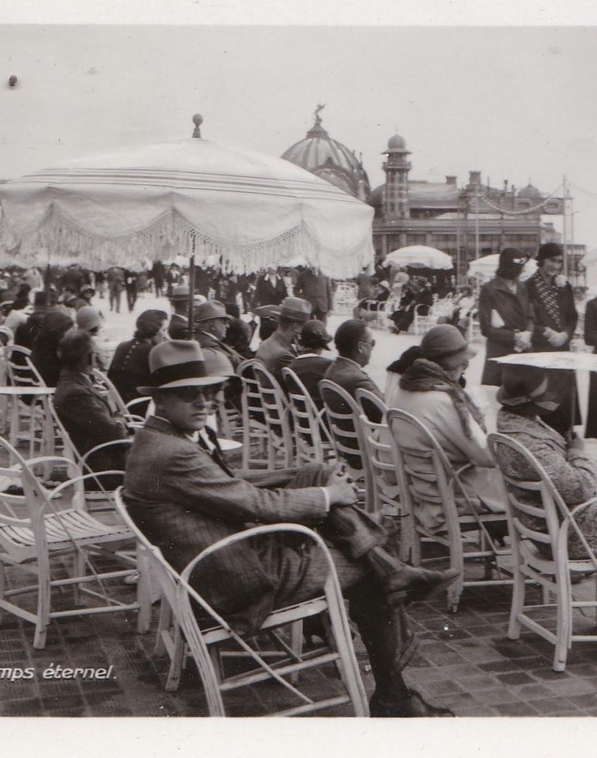
1. Why Eva Freud?
Their lives and deaths shed light:
On Nice and the Lycée Calmette
-as topography of memory
-as archives of history

Slide 28

2. The Project
Several courses
Over 2 semesters
In collaboration with the terminal HPL of the Lycée Calmette and their philosophy teacher.
With joint meetings
With an excursion to Thorenc
With a final theater performance

Slide 29
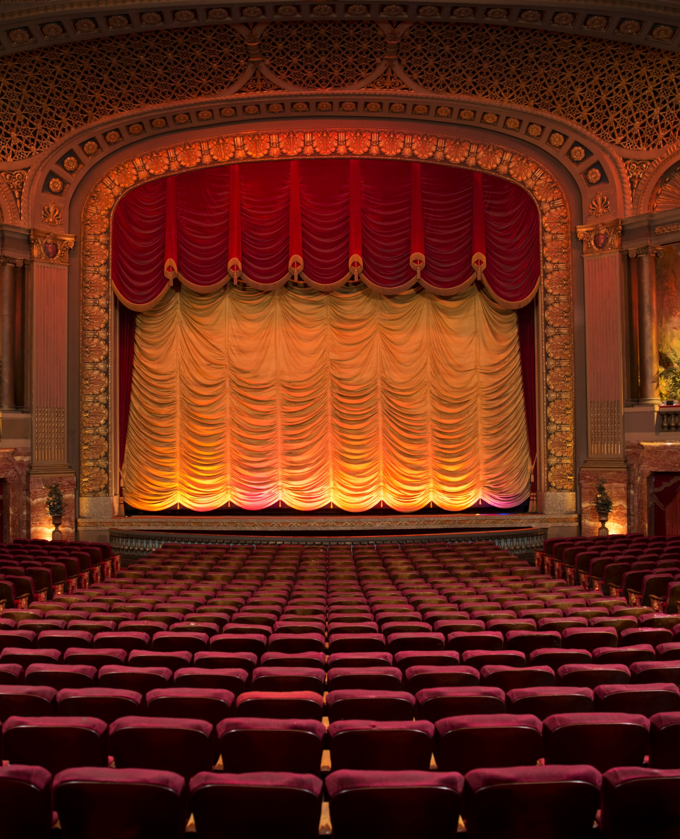
3. Important dates:
First meeting at the Calmette high school between the students of the final year of high school specializing in HLP and the undergraduate students. Presentation of the Calmette high school as a place of memory of the Shoah in Nice. Meeting with the President of the AMEJDAM (Association for the Memory of Deported Jewish Children of the Alpes-Maritimes) Mrs. Merowka, who will explain to the students the historical research process to find the names of the deported girls from the high school in order to affix the commemorative plaque at the Calmette high school. Presentation of a video, made by the students.
Second meeting between students and high school students: workshop of theatrical reading of Eva Freud's letters at the Faculty of Letters. Welcome by the director of EUR Creates, Mr. Aubert.
Outing to Thorenc: discovery of Eva's pen pal Hélène Dub's hiding place, of the various places where Jews were arrested and of the commemorative plaque
Performance of theatrical readings in collaboration with the students.Théâtre du Grand Château, Valrose

Slide 30

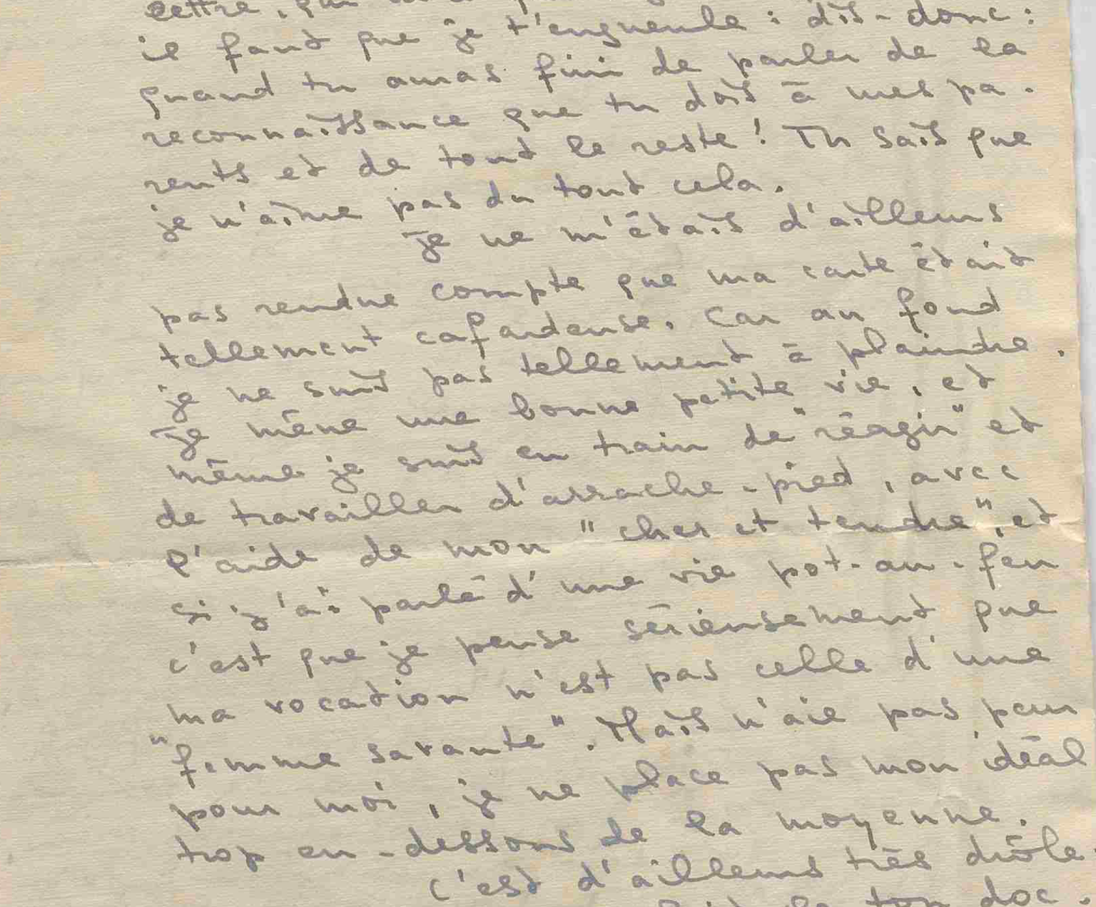
4. Cours programm and structure
Working material:
Letters, photographs, documents from archives, historical sources
Procedure:
Description and analysis of documents and their contextualization
Writing workshop – student/pupils’ texts and scenarios
Scenic representation and reading presentation of letters and student/pupil’s texts
Grading: 1 grade for active participation in the project. 1 grade for production within the course. The average will be counted for all courses involved.

Slide 31
Final assessment : The project as vector of coherence
Transdisciplinarity of subjects
Connecting different fields of CK (history, littérature)
Connecting CK, PCK and PK through the project work
Linking theory and practice
Enhancing self reflection
The pupils and students felt that they had:
learned to reflect out of the box,
adapt to unfamiliar environments,
adopt new perspectives,
create links between different fields of knowledge.

